Slide 1
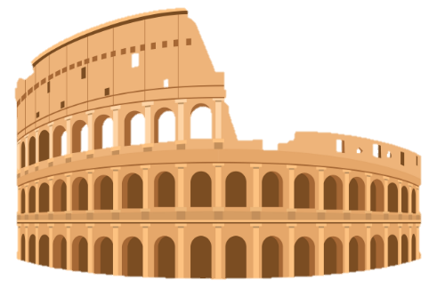
Roman entertainment: a trip to the theatre and amphitheatre

Slide 2
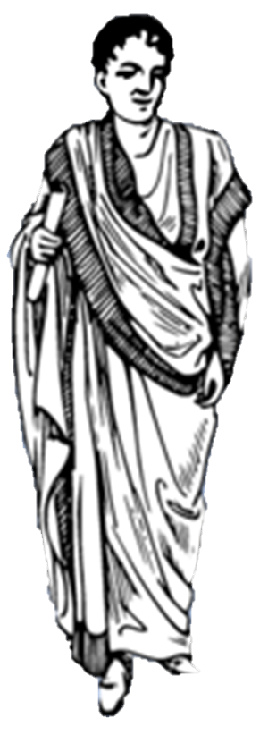
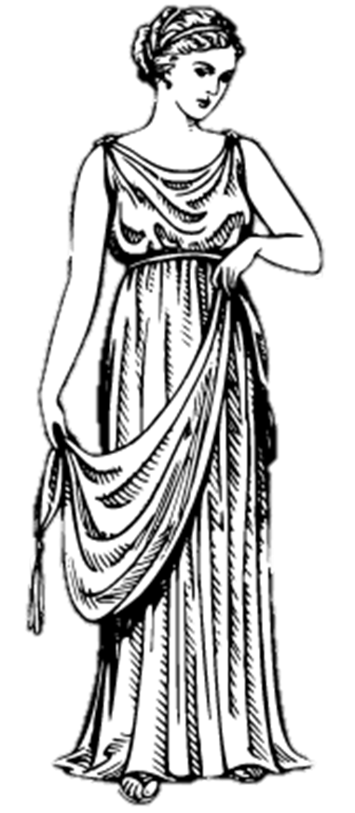
Roman entertainment
Nowadays people might go to the park or the cinema to have fun at the weekend. What did the Romans do?
This week Advorix and Julia (you might remember them from previous weeks) will take us to have a look at Roman theatres and amphitheatres.
Let’s go!

Slide 3
What’s the difference between a theatre and an amphitheatre?
Good question! The words are quite similar.
An amphitheatre is a full circle shape, while a theatre is only half a circle.
In modern terms, an amphitheatre is more like a stadium while a theatre is more like a cinema.

Slide 4
Amphitheatres
Do you recognise this amphitheatre? Yes, that’s right, it’s the Colosseum in Rome!
It’s a bit broken nowadays, but if you use your imagination, you can imagine what it used to look like… It was really impressive!

Slide 5
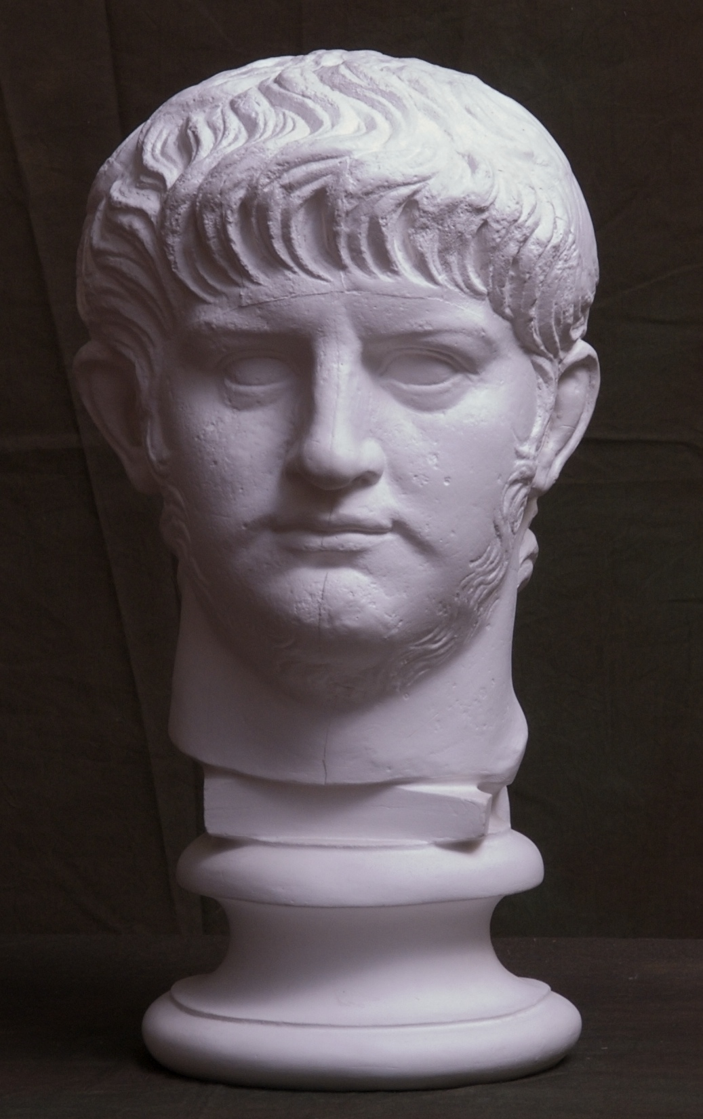
Nero
Before the Colosseum was built, the emperor Nero built his luxury Domus aurea (Golden house) on top of people’s homes which were burnt down during the Fire of Rome.
People thought that Nero was a cruel tyrant who didn’t care about the people who had lost their homes. You can see a picture of Nero here.

Slide 6
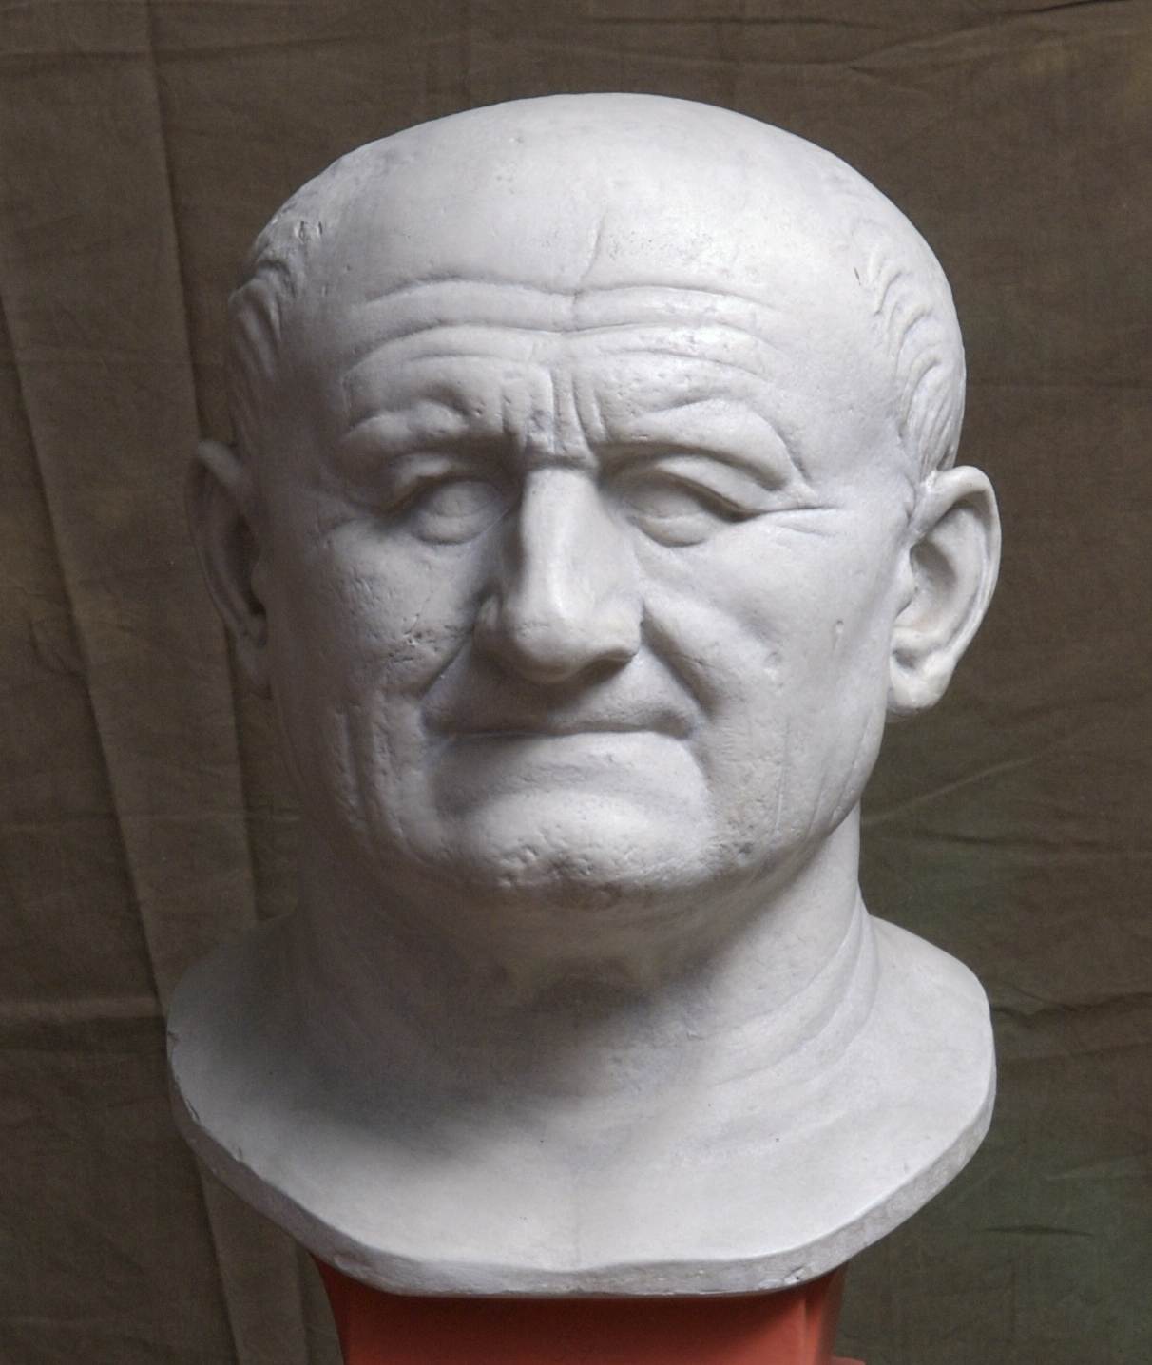
The Colosseum
The emperor after Nero was called Vespasian – you can see a picture of him here. Vespasian wanted to show how much he cared for the Roman people.
To do this, he knocked down Nero’s Golden House and he built a huge amphitheatre over it. This showed that he cared more about the Roman people having fun than him having a luxury house.

Slide 7
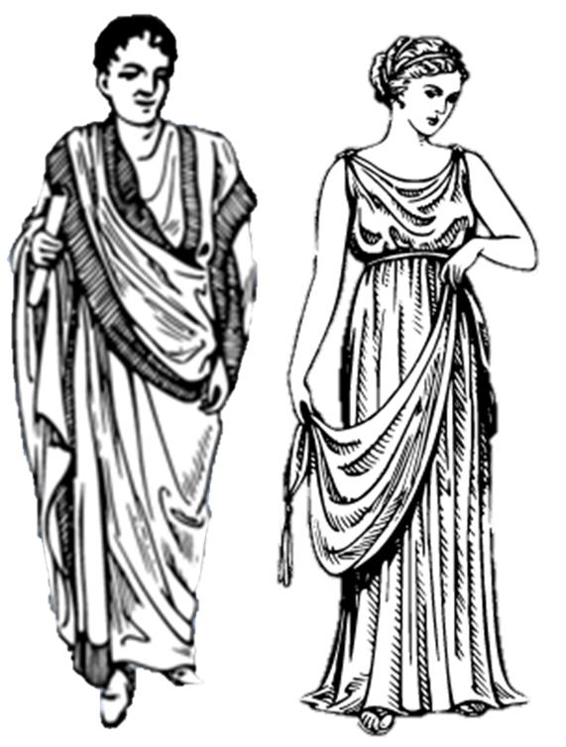
A day at the amphitheatre
So what could you see at the amphitheatre? Let’s take a look with Advorix and Julia!

Slide 8
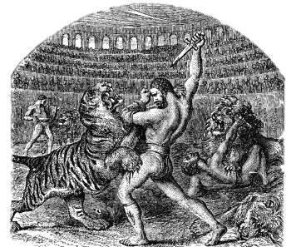
Gladiators
Gladiators were highly trained fighters who fought in the amphitheatre. Many of them were enslaved people like Advorix, or prisoners captured during war. They were trained in gladiator schools and forced to fight each other, sometimes to the death.

Slide 9
Venationes
Gladiators would also fight wild exotic animals in venationes (wild animal fights). These animals could include lions, tigers, giraffes, and elephants. It was a very dangerous job, but sometimes gladiators could become very famous.

Slide 10
Naumachiae
Sometimes the entire amphitheatre could be filled with water so that fake Naumachiae (sea battles) could take place. These were really impressive – it was just like watching a real battle!

Slide 11
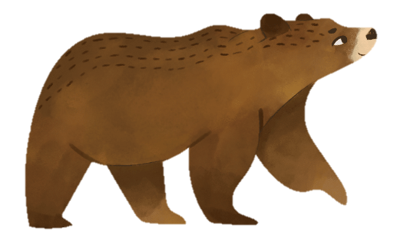
Executions
Unfortunately, some people were also executed in the amphitheatre.
Some were condemned ad bestias (to the beasts) and were torn apart by wild animals, and others were forced to take part in executions based on gruesome deaths from mythology (e.g. falling out of the sky like Icarus).

Slide 12
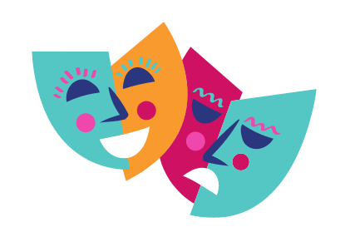
Theatres
Well that was quite gruesome! Let’s go to the theatre instead.
The theatre was quite different to the amphitheatre. At the theatre you could go to see different plays – these could be comedies or tragedies.
Let’s see what’s being performed at the Theatre of Pompey in Rome!

Slide 13
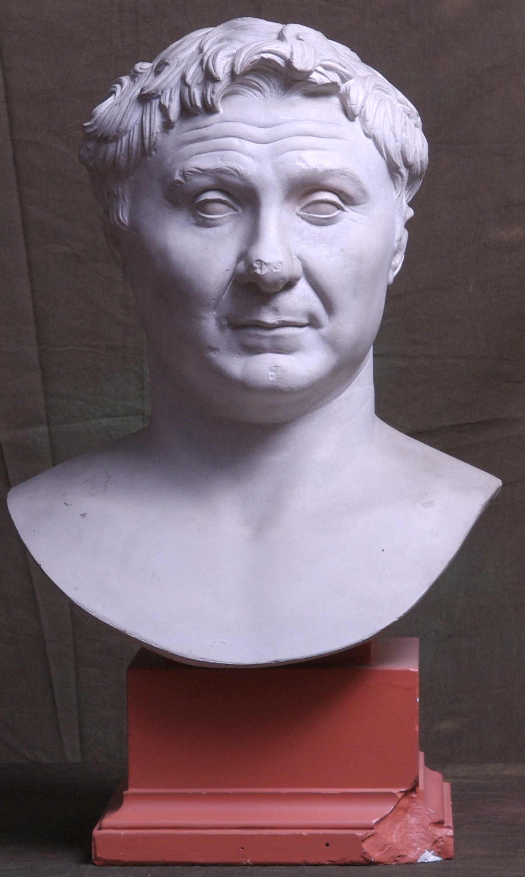
The Theatre of Pompey
Like the Colosseum, the Theatre of Pompey was built to be a crowd-pleaser. It was a very special theatre because it was the first permanent stone theatre to be built in Rome. It was built by Pompey, who was at times a friend, and at other times an enemy of Julius Caesar. At the theatre you could watch comedies or tragedies.

Slide 14
Comedies
Roman comedies were really funny! In a Roman comedy there would be lots of confusion and mistaken identities. Two of the most famous comic playwrights were called Plautus and Terence – these writers borrowed ideas and plots from Greek comedy.
Many of Shakespeare’s comedies, such as The Comedy of Errors, are based on Roman comedies.

Slide 15
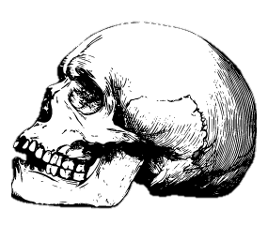
Tragedies
Roman tragedies were the opposite – they were really sad.
This week you are learning about myths. Many of the plots of tragedies were based on really sad Greek myths with lots of death. If misunderstandings took place in tragedies, they would have tragic consequences, unlike the happy endings in comedy.

Slide 16
Actors
Roman actors were not like actors today. In Ancient Rome, actors were at the bottom of society. They were not allowed to vote or join the army like normal citizens. Many of them were actually enslaved people, and could be punished for a bad performance.
Romans looked down on actors, whereas nowadays people look up to famous actors.

Slide 17
Nero and the theatre
Do you remember Nero? Another reason that people didn’t like him was that he wanted to be an actor. Since most actors were slaves, this was unacceptable for an emperor. Not only that, but biographers write that his singing was awful!

Slide 18
What a diva!
Nero loved acting so much that he kept performing even during an earthquake!
He wouldn’t let anybody leave the theatre while he was performing, so some pregnant women even had to give birth in the theatre! Some people were so tired of his singing that they pretended to be dead so that they would be taken out of the theatre.

Slide 19
Thank you for coming!
Phew, luckily we didn’t have to sit in on one of Nero’s performances! If you were in Rome for a day, what would you prefer to see? A gladiator fight in the amphitheatre? Or perhaps a comedy in the theatre?
We hope you enjoyed our tour of the Roman theatres and amphitheatres!

