Slide 1
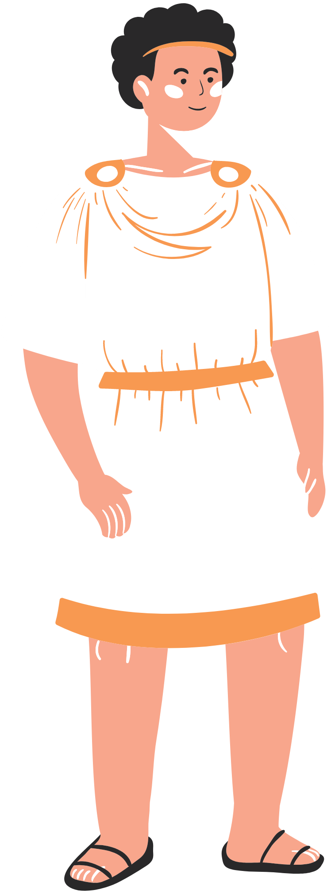
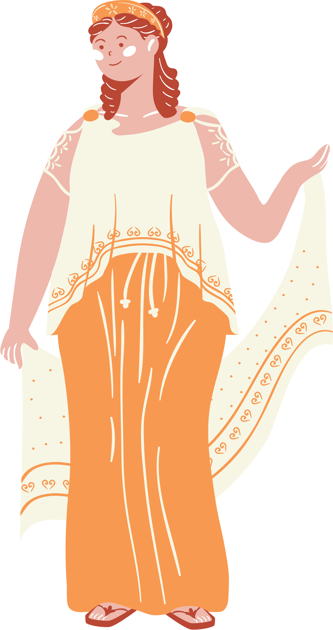
Latin Greetings
The Latin Primary Project

Slide 2
Today's Lesson
Salve! Today we will be learning how the Ancient Romans would say hello to each other! By the end of this activity you will also be able to ask and answer your own questions in Latin.

Slide 3
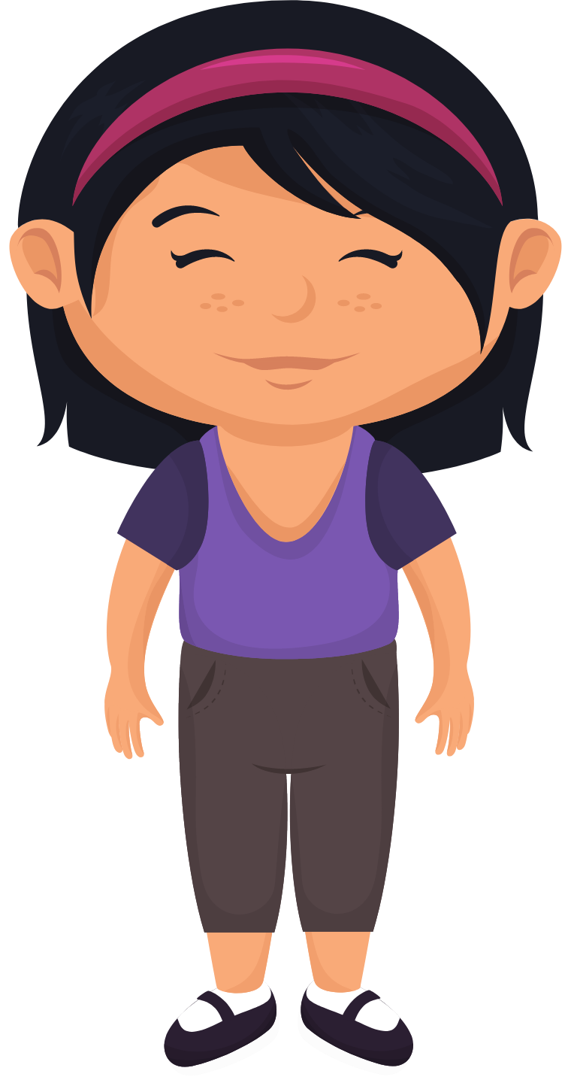
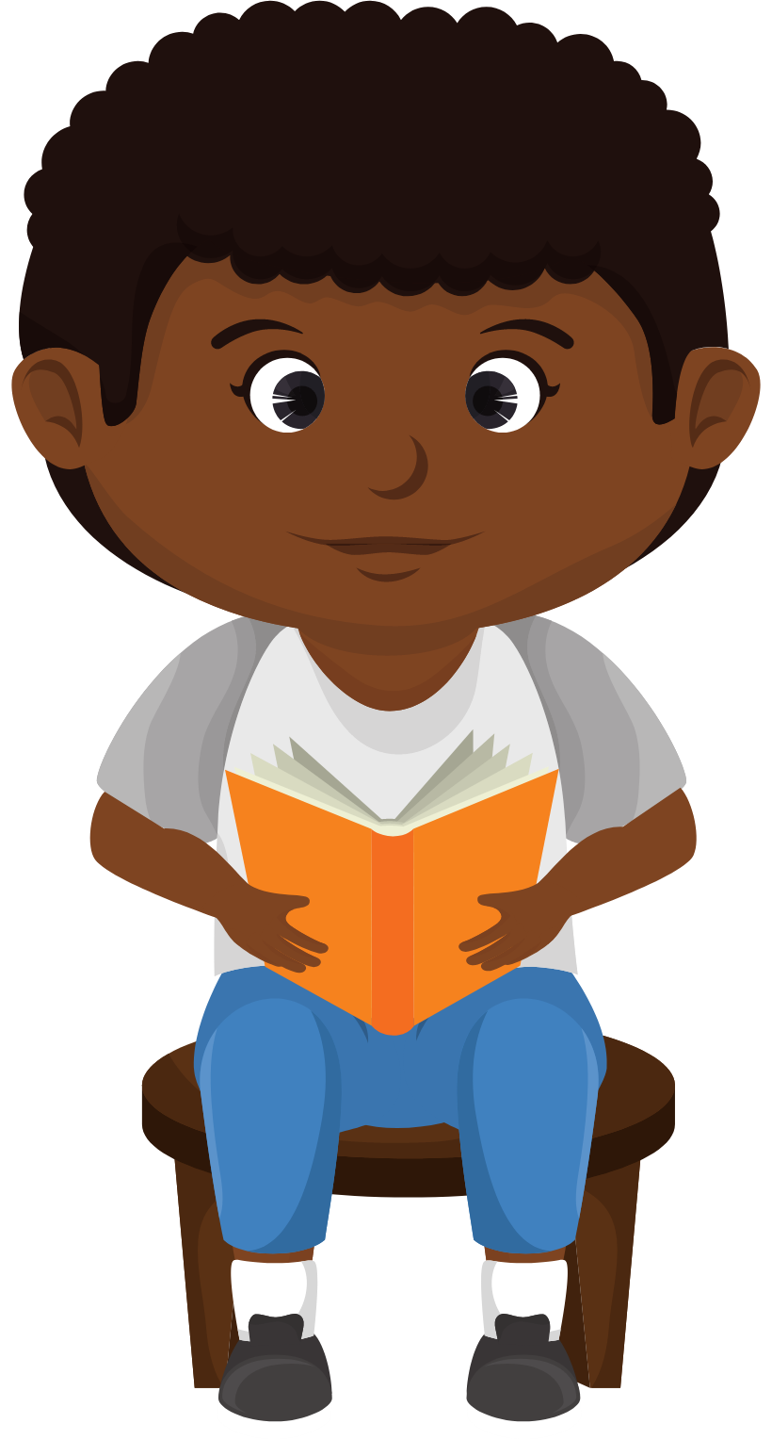
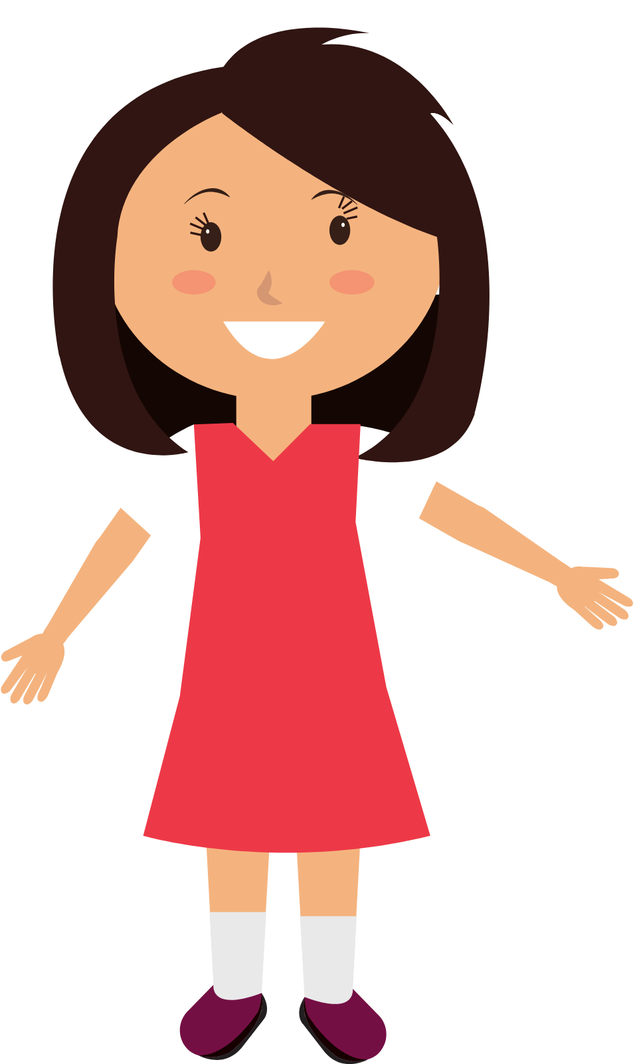
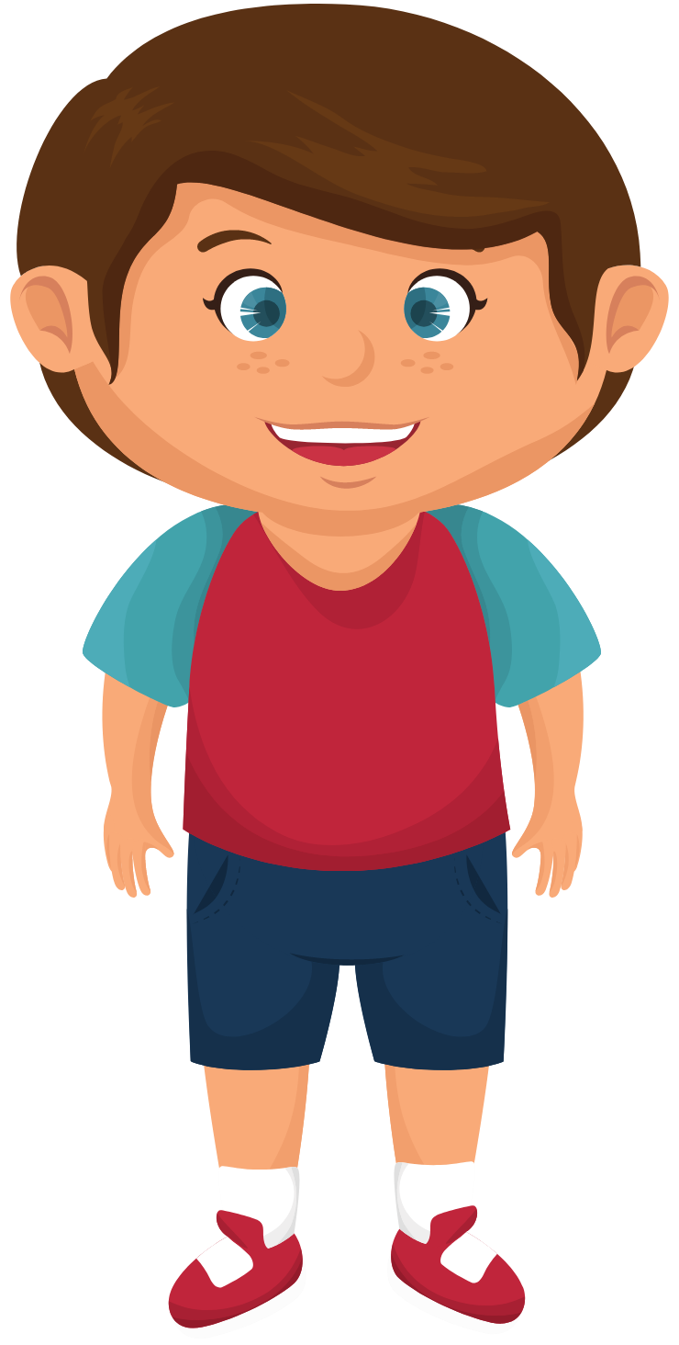
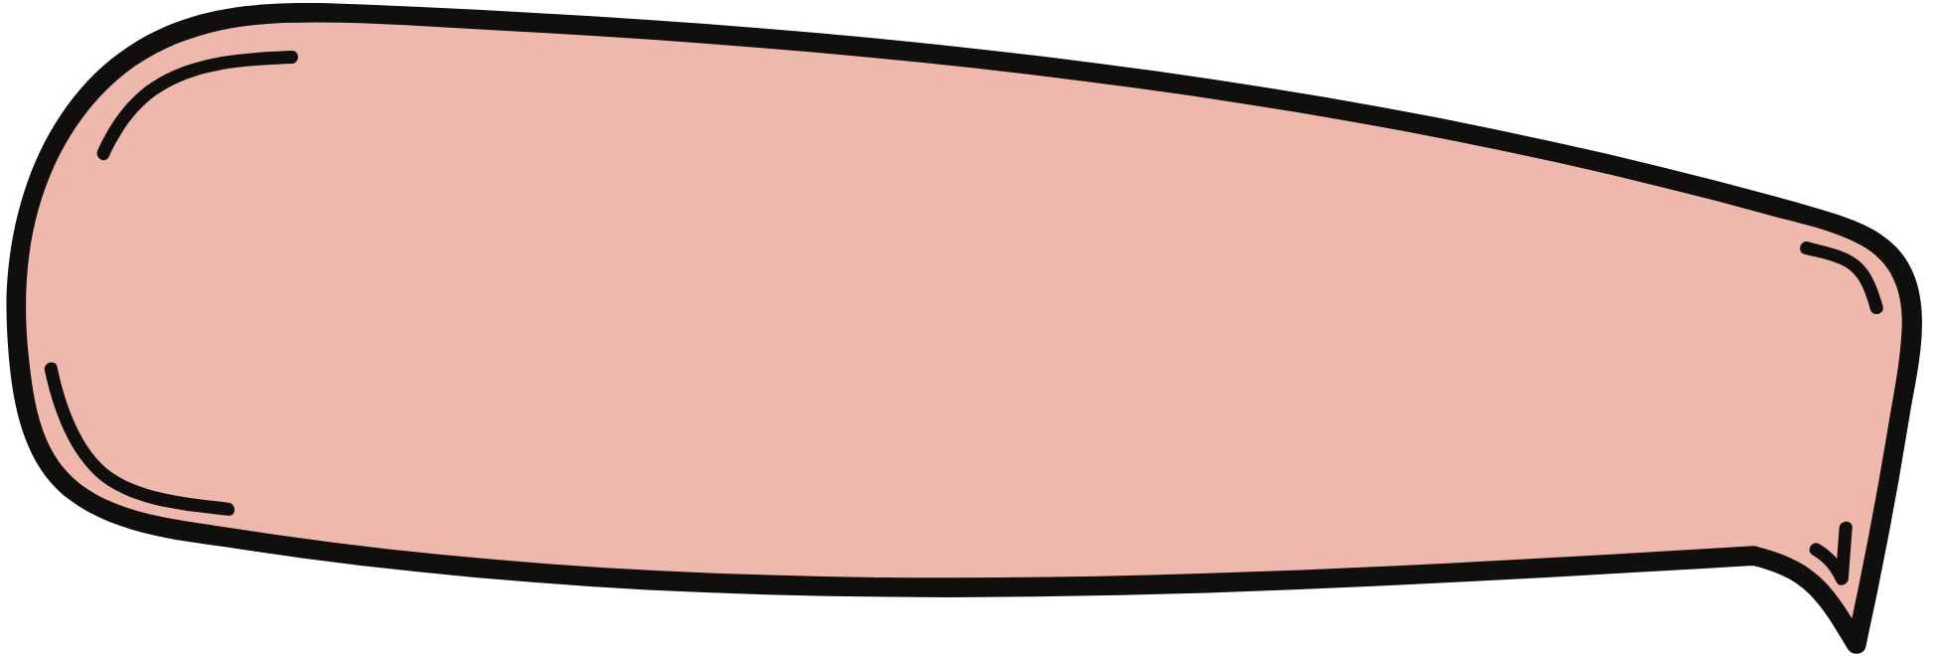
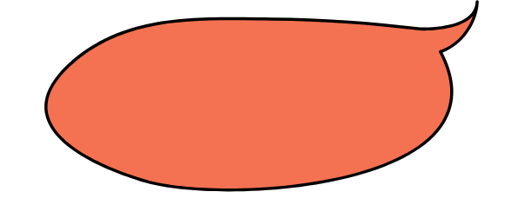
How many different ways can you think of that we greet each other in English?
Hello!
Hi!
What's
up?
How are you?
Hey!
Good morning!

Slide 4
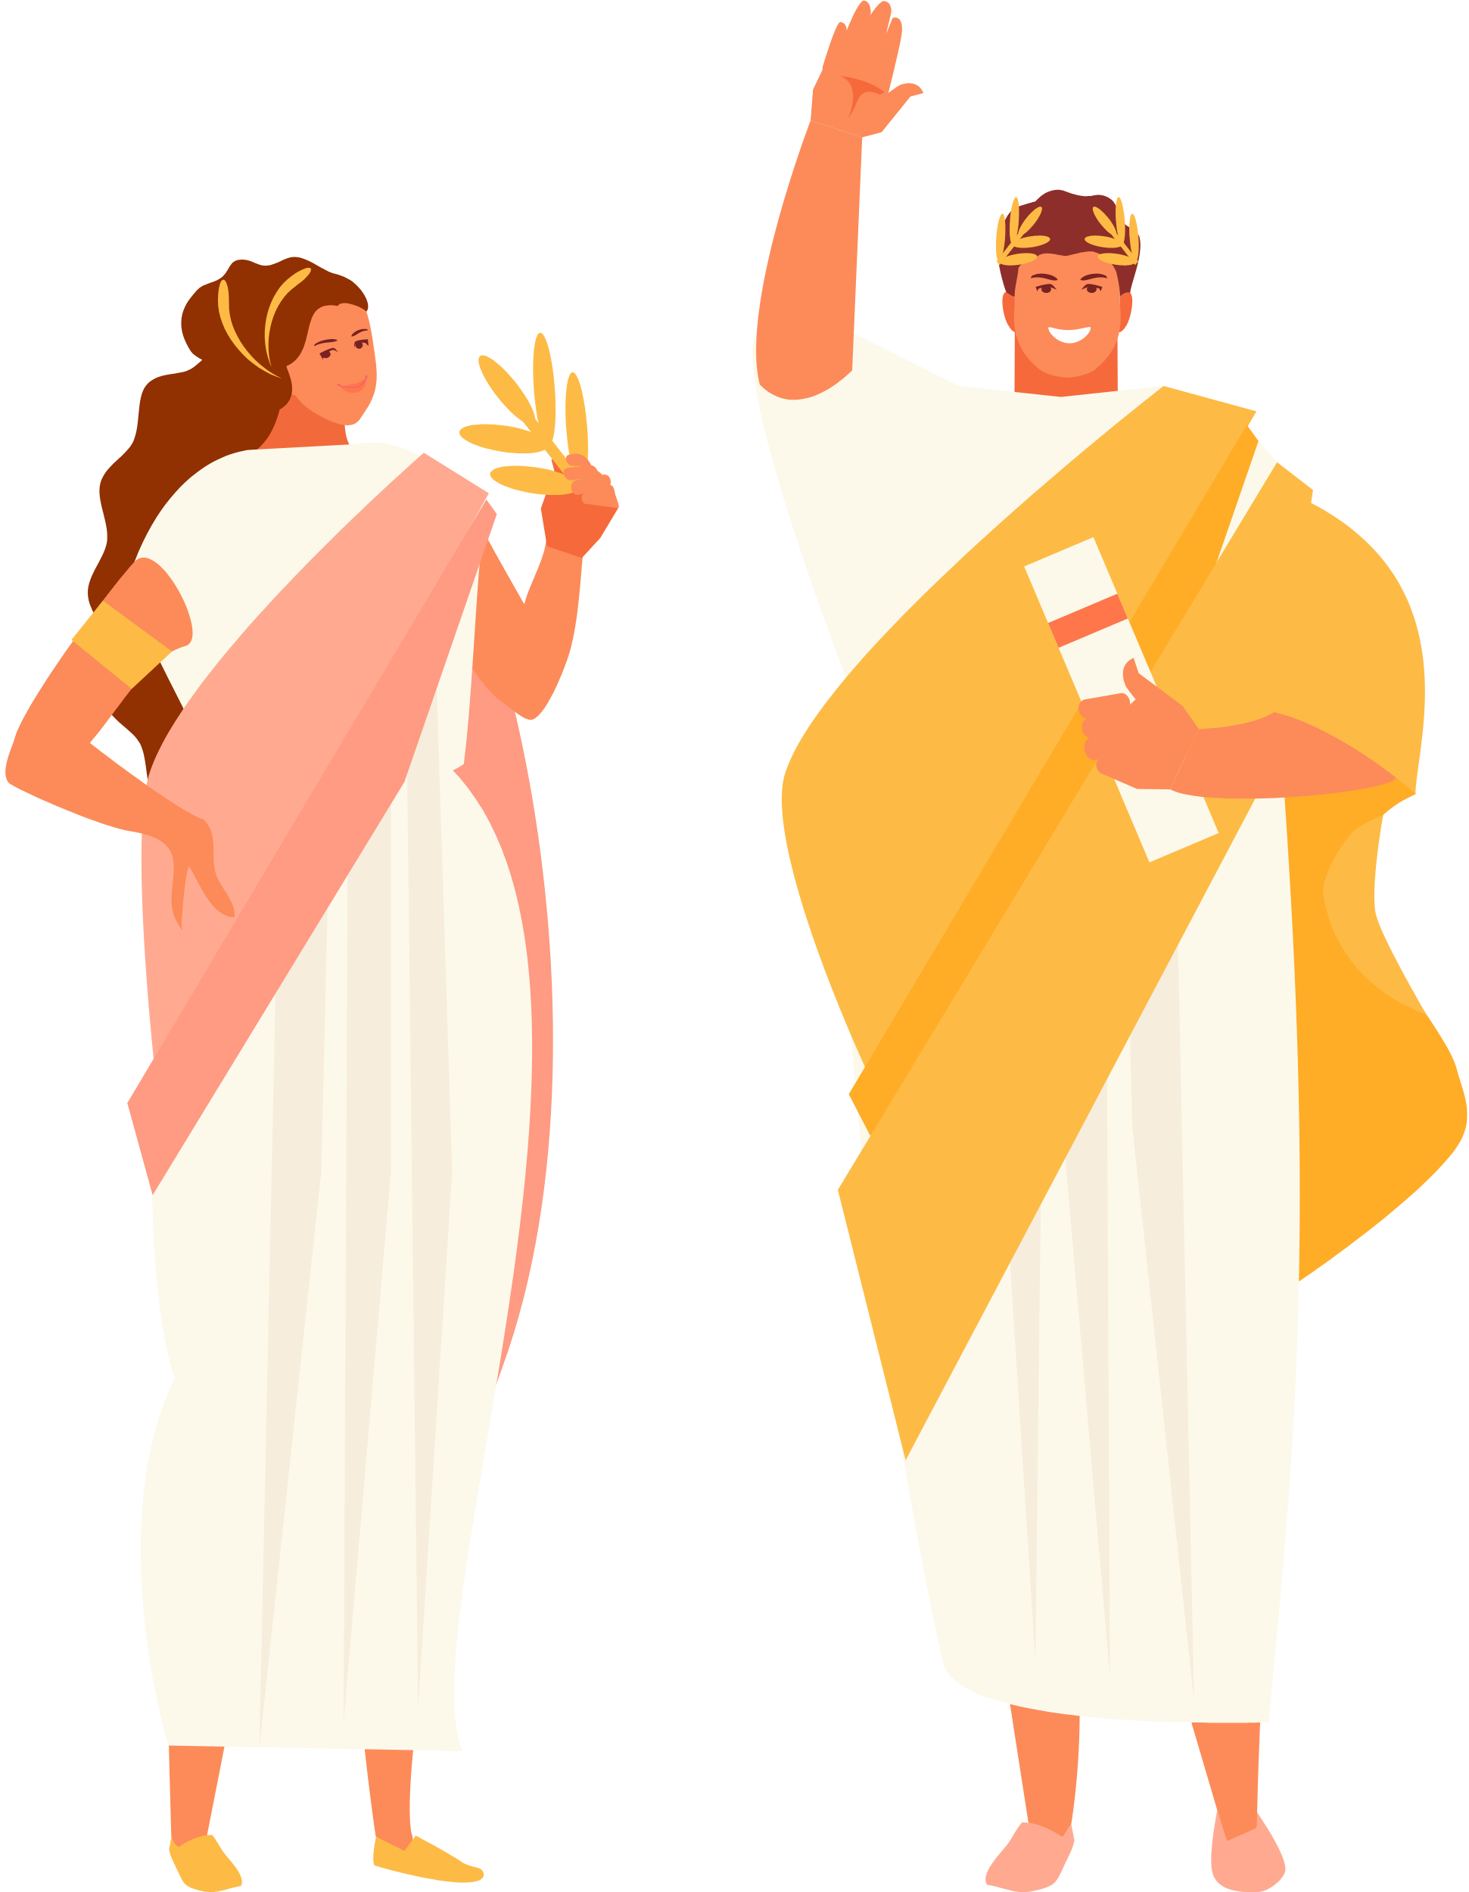
Salve and Vale!
Salve
Julia!
Salve
Quintus!
In Latin, salve means hello! Or good morning!
Vale is how you say goodbye in Latin.

Slide 5
Greetings Continued.
quid agis?
You could also greet someone by asking, how are you?
Or if you want to speak like a Roman:
quid agis?
bene means that this boy is feeling good!
bene!

Slide 6
Meeting Marcus
But wait! We don't even know the name of this boy yet! Shall we ask?
quid est
teum nomen?
meum nomen
est Marcus
Ah, the boy said 'my name is Marcus'. How about you?
What is your name? Quid est teum nomen?

Slide 7
We should be polite and say thank you to Marcus. What do you think 'thank you' is in Latin?
a) equus
c) salutatio
b) gratias
d) dormio
Here is a hint to help you out!
The English word 'gratitude' is from this Latin root and so shares a lot of the same letters!

Slide 8
The answer is gratias! And salutatio can be used to say ‘You are welcome’.
Salutatio!
Gratias!

Slide 9
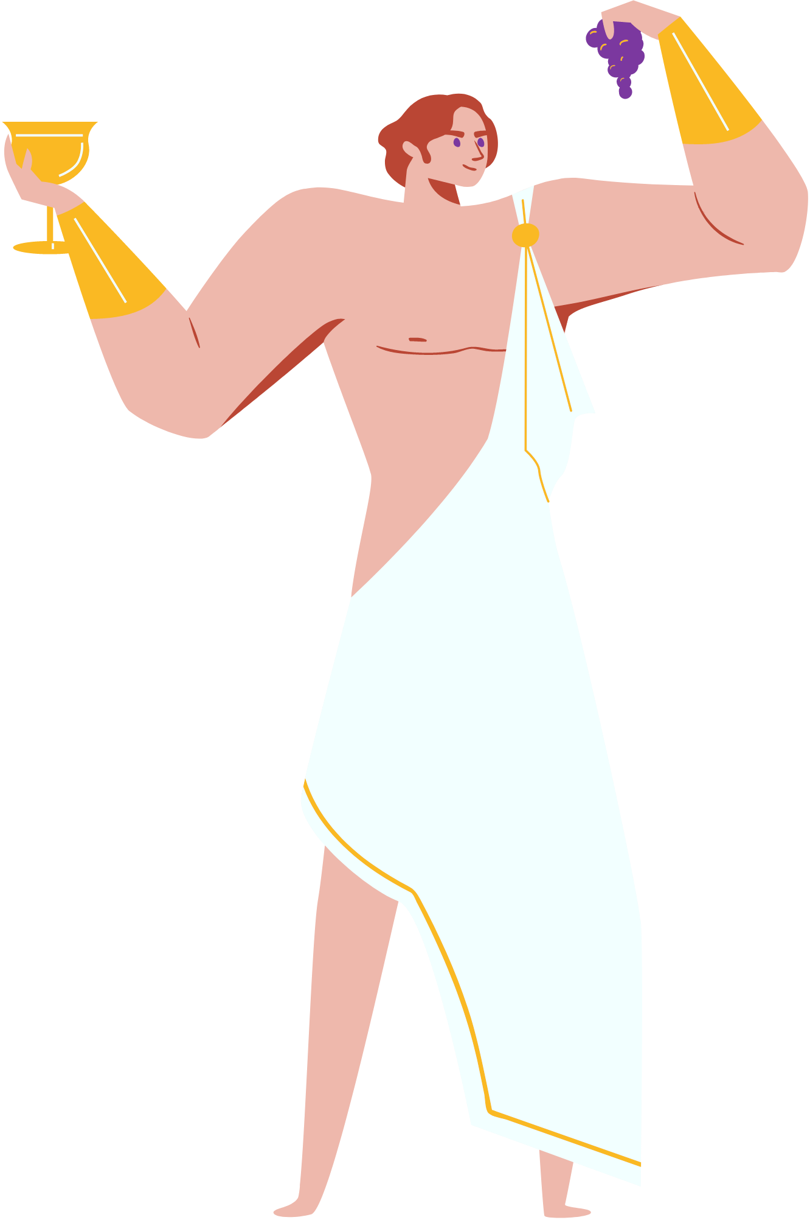
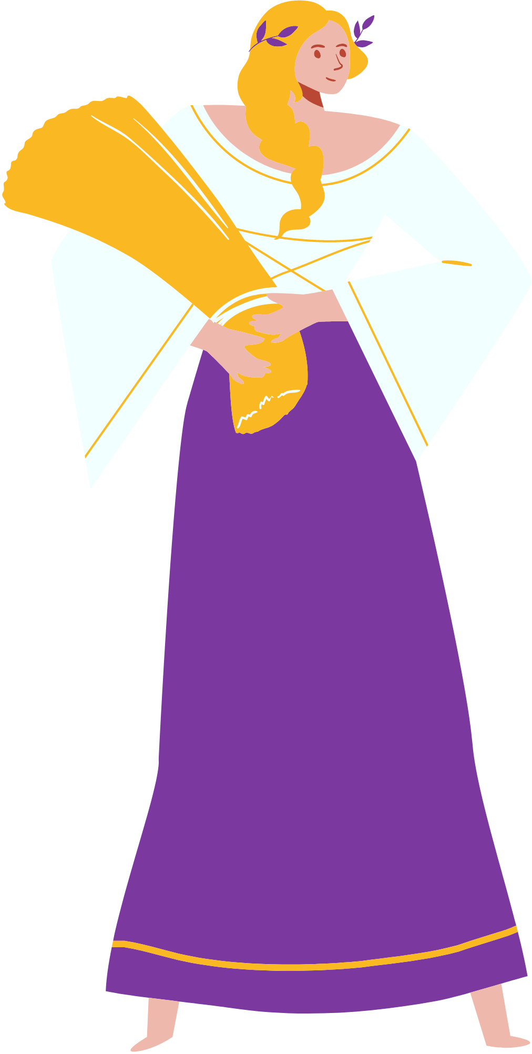
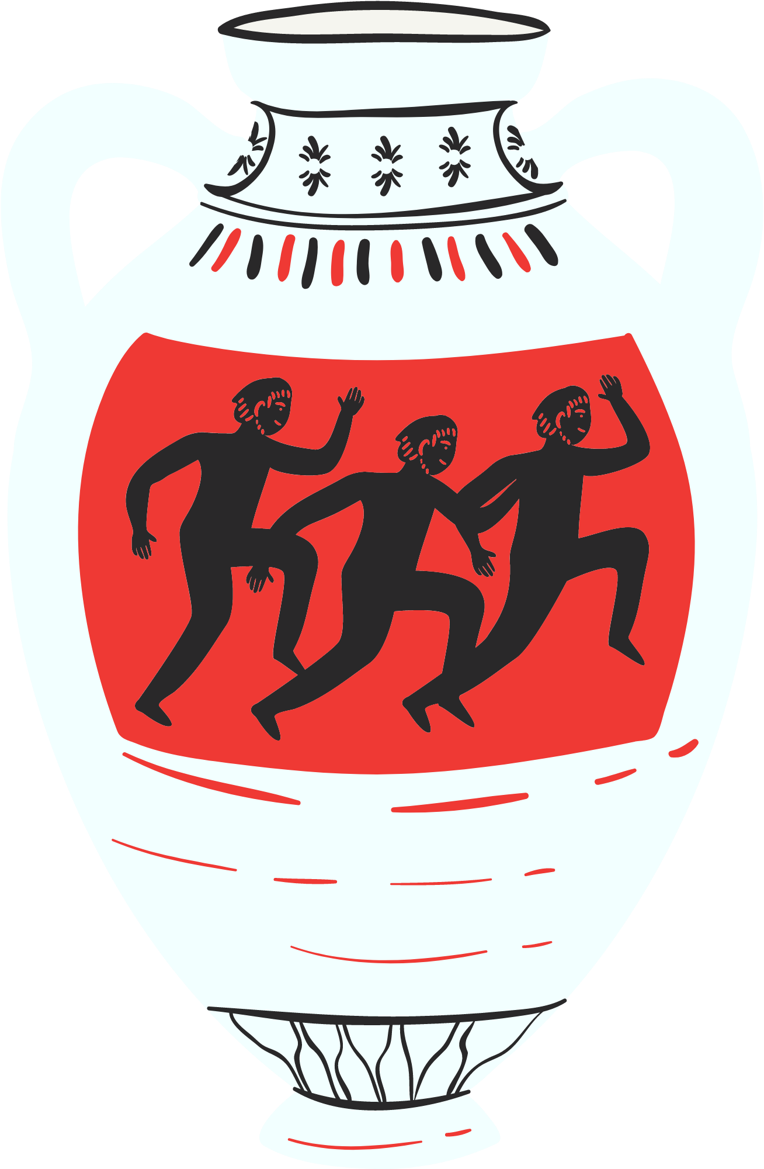
Activity Time
You will need to download the worksheet from our website for this next part, get ready to test your new Latin knowledge!

Slide 10
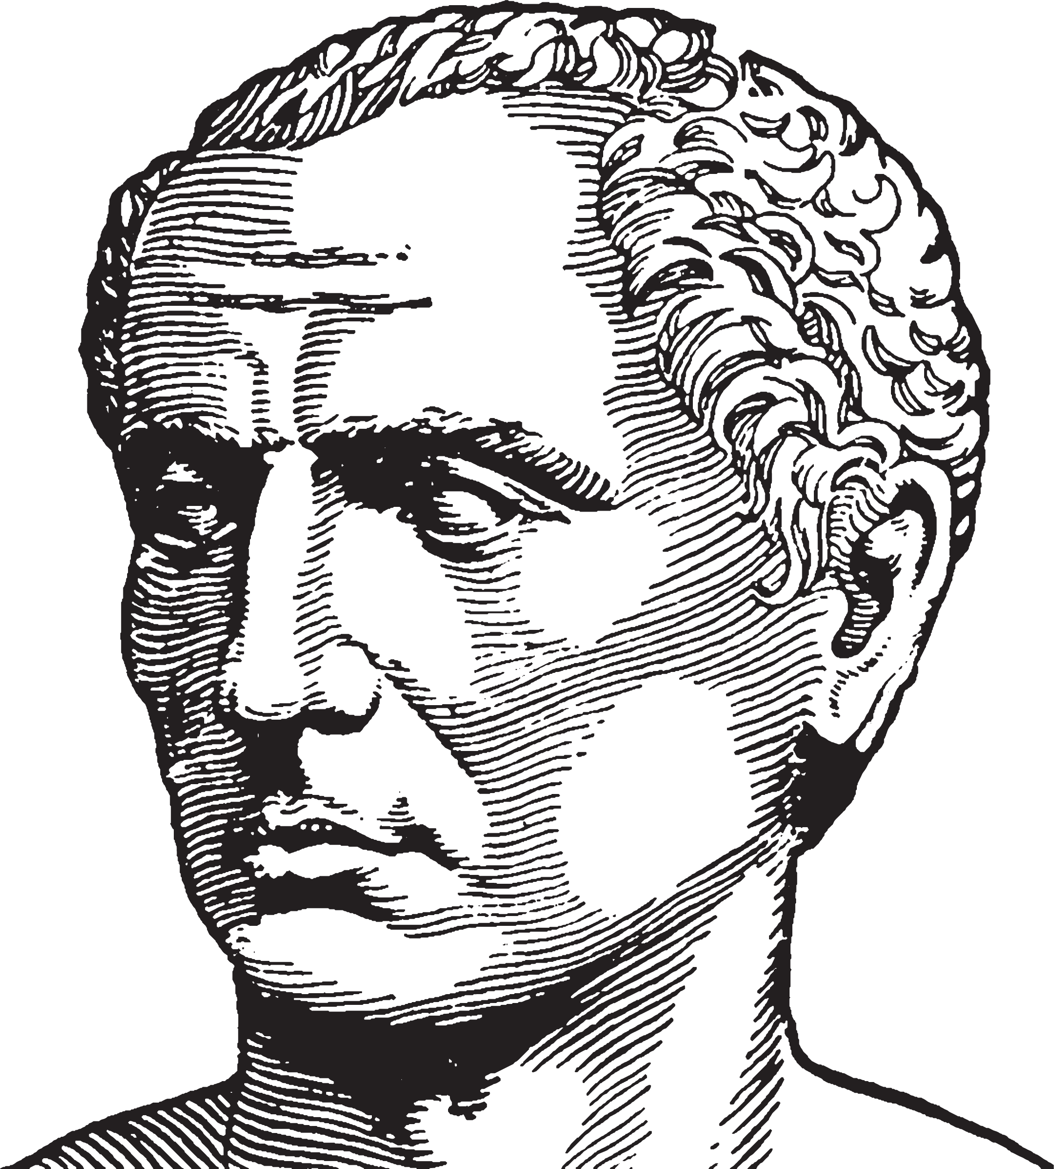
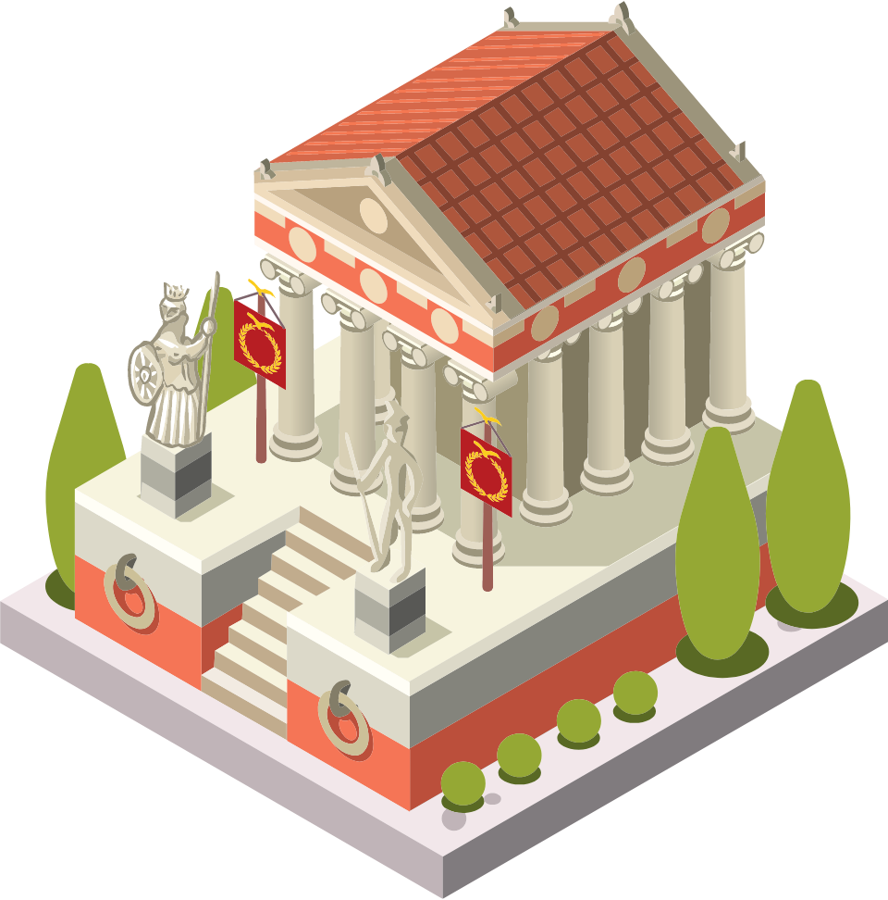
Marcus meets Julius Caesar.
Something very exciting has happened! Marcus has received a letter inviting him to visit Julius Caesar, the great Roman General, at his beautiful home.

Slide 11
Marcus Needs Help
But Marcus is so nervous that when he arrives he completely forgets all of his Latin and doesn't know how to answer Caesar!
Help Marcus by using your worksheet and writing the correct Latin answer to the question!
If you need any help,
look back over this presentation to remember
all of the new words
that we've learnt.

Slide 12
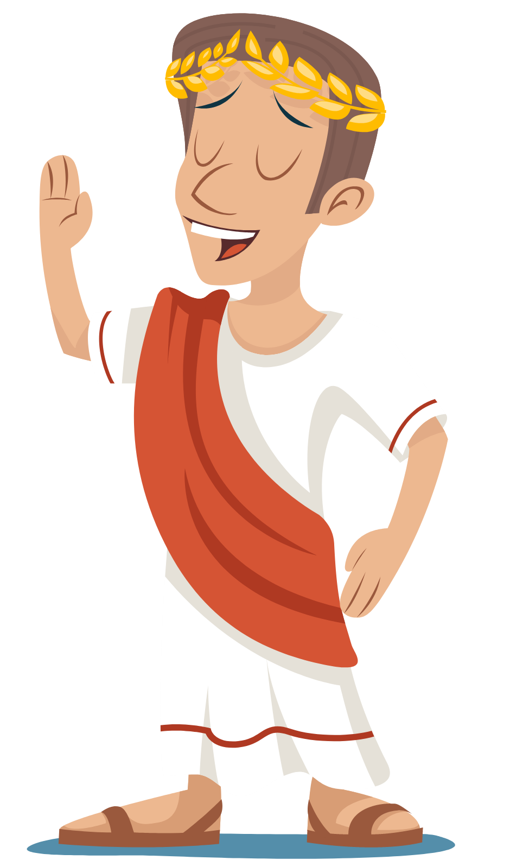
You’re Ready!
Now that you can speak enough Latin to greet the most famous general of Rome himself! Try to use the new words you've learnt to say hello to someone and teach them how to respond!
Now all that’s left to say is....

Slide 13
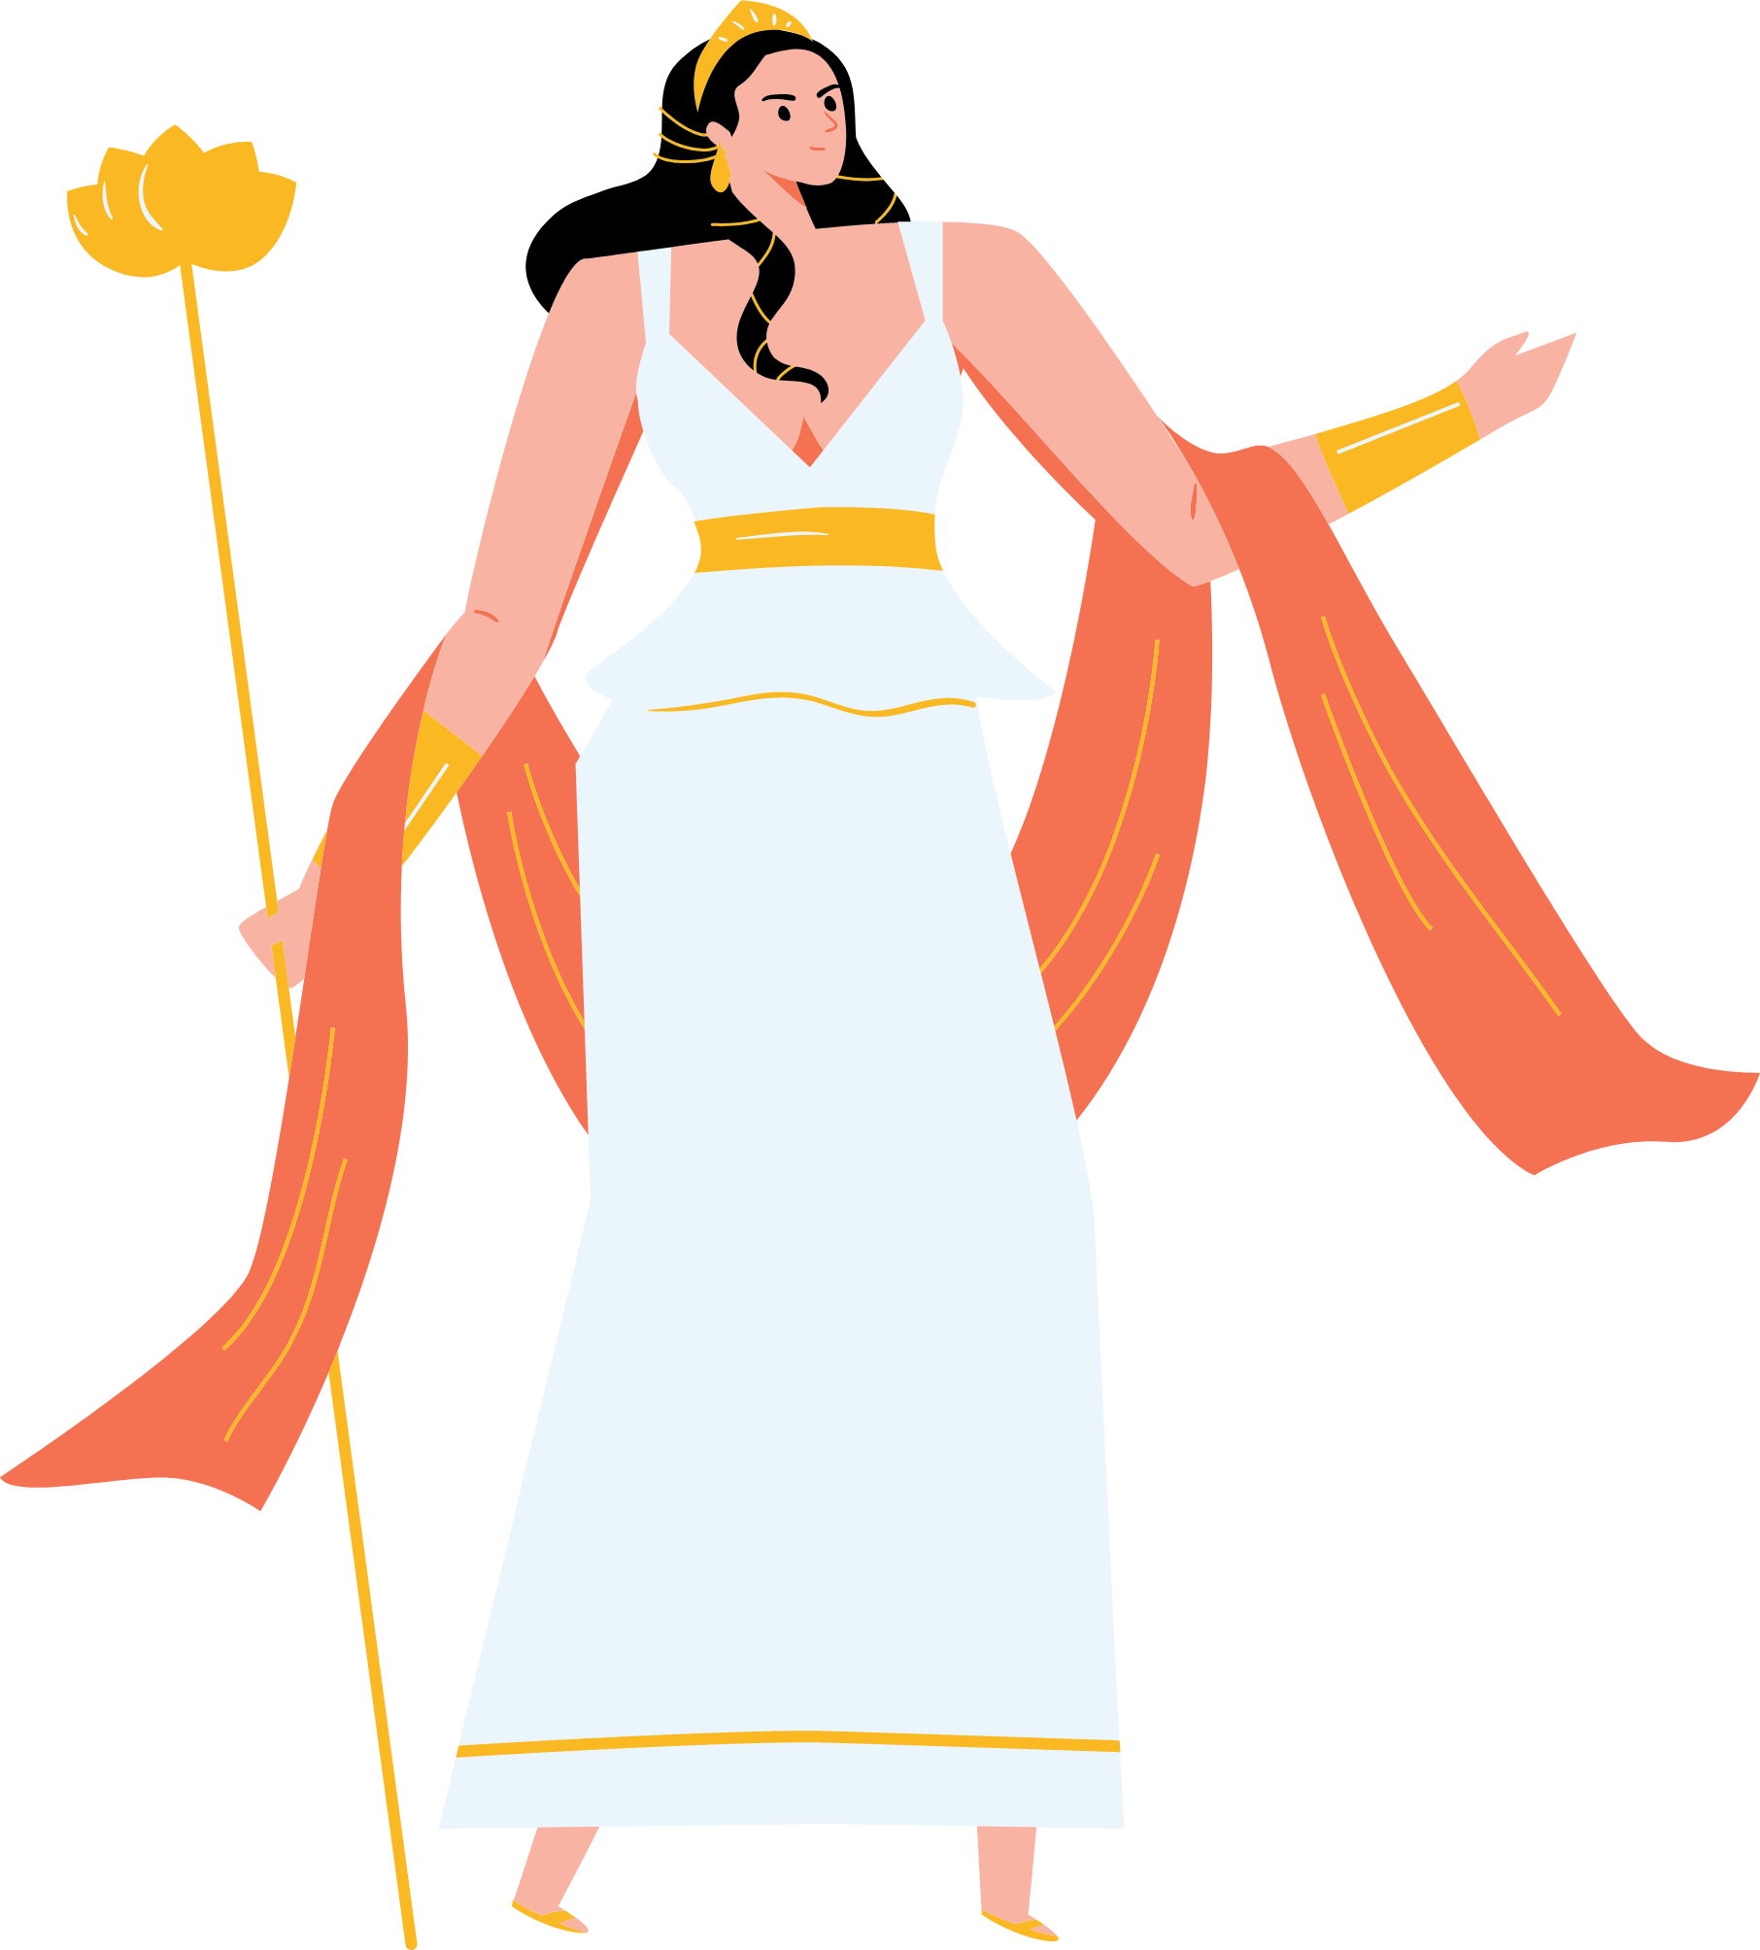
Gratias! Vale!

