Slide 1
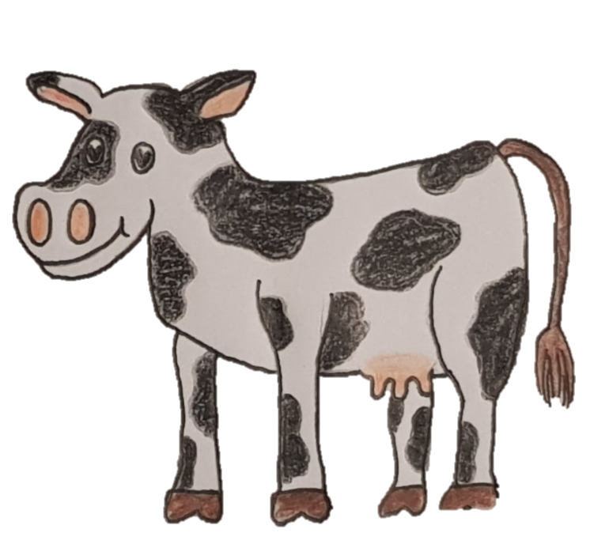
Nominative and Accusative Plurals
Vacca
Cow
You can see in our examples we have a cow in the nominative and a cow in the accusative. We call this singular. But what if we had more than one cow?
Amo meam vaccam
I love my cow

Slide 2
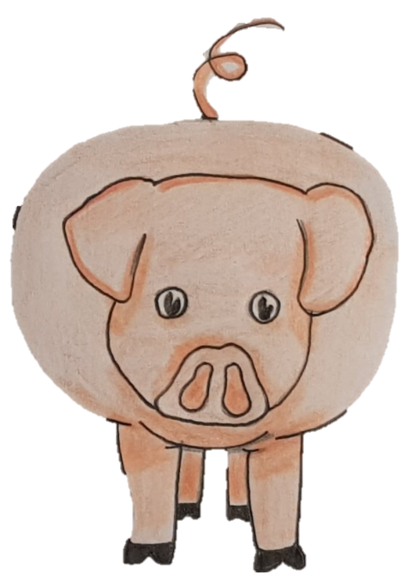
Nominative
Vaccae
Accusative
Vaccas
Nominative
Porci
Accusative
Porcos

Slide 3
We put them into their plural form!
What did you notice?
If there is more than one of something, we need to put them into the plural.
There is a nominative and accusative plural form.

Slide 4
Here’s some nouns you’ve learnt in the plural.
Masculine Nominative Plural
Filii
Boys
Pulli
Chickens
Patres
Fathers
Fratres
Brothers
Masculine Accusative Plural
Filios
Pullos
Patres
Fratres
Feminine Nominative Plural
Filiae
Girls
Arae
Altars
Vulpes
Foxes
Matres
Mothers
Feminine Accusative Plural
Filias
Aras
Vulpes
Matres

Slide 5
Neuter plural is easy – they are the same in the nominative and accusative!
Templa
temples
Theatra
theatres
Caela
skies
Consilia
plans
Dona
gifts
Neuter Nominative Plural
Templa
temples
Theatra
theatres
Caela
skies
Consilia
plans
Dona
gifts
Neuter Accusative
Plural

Slide 6
Can you write the nominative and accusative plurals in for each noun?
Nominative Plural:
Accusative Plural:
Equus
Impluvium
?
?
Canis
?
?
Ianua
?
?

Slide 7
Answers! No Peeking!
Nominative Plural:
Equi
Accusative Plural:
Equos
Equus
Impluvium
Impluvia
Impluvia
Canis
Canes
Canes
Ianua
Ianuae
Ianuas

Slide 8
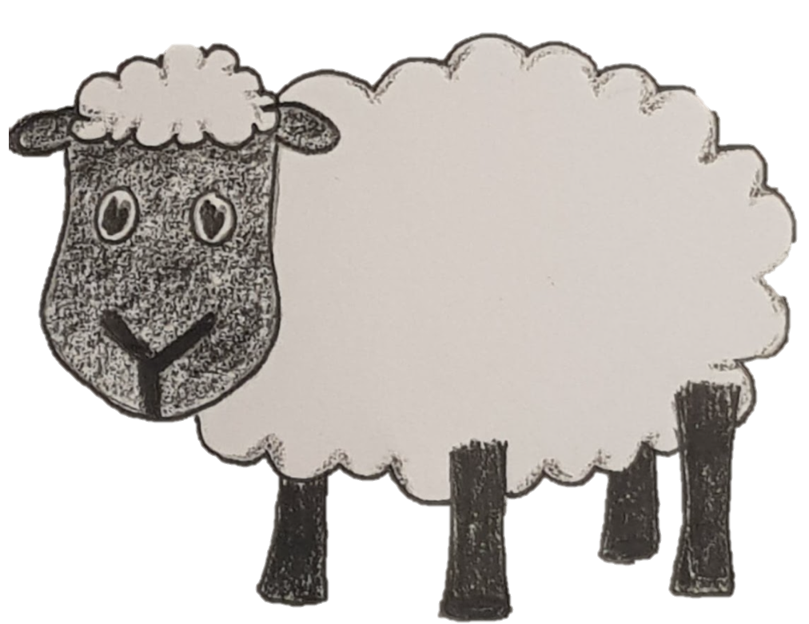
Lucius habet quinque oves.
Lucius has five sheep.
Do you see how the plurals work?

