Slide 1
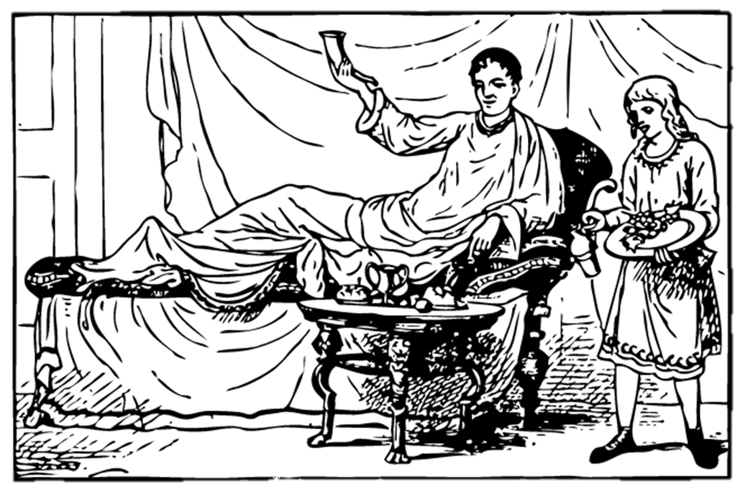
The Roman Dinner Party and the Problems of Slavery

Slide 2
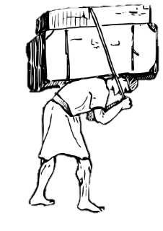
The Roman Dinner Party
An important part of elite Roman life was the convivium (dinner party).
However, since Rome was a slave-based society, running social events like this relied heavily on slave labour.
This week we’re going to take a look at Roman life from a different point of view: meet Advorix.

Slide 3
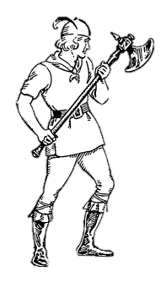
Meet Advorix!
My name is Advorix. I used to be a warrior from a tribe in Gaul (that’s modern France).
However, when the Romans invaded my country, they enslaved my people.
I was taken to Italy and now I am a Roman slave.

Slide 4
What is slavery?
Enslaved people were forced to work for no money, and were often treated badly.
They didn’t have the power to make their own decisions about their own lives.
Unfortunately, slavery is a problem which has continued to modern times.

Slide 5
Marcus
My dominus (translated as master or enslaver) is a man called Marcus. He is a wealthy Roman with a large villa (country house) and farm.
He bought me at the slave market, and now I work on his farm.
I am forced to work hard every day without any reward. I can no longer see my family because they were also sold into slavery.

Slide 6
Dinner party
Tonight my dominus is going to have a dinner party with his friends. I have to work hard today so that everything is ready for the party. I will carry amphorae (jugs) of wine to the house.
It’s heavy work!

Slide 7
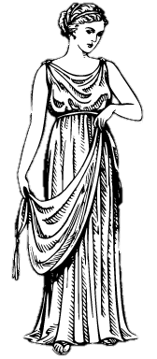
Julia
One of Marcus’ guests is Julia (you might remember her from the house and town tours).
She is a wealthy Roman woman, so she can take part in the convivium.
Salve!

Slide 8
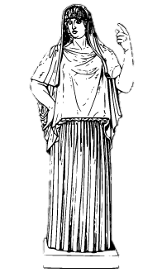
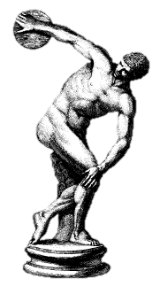
Decoration
Marcus’ villa is filled with lots of decoration.
As you saw on Julia’s tour, the walls of the atrium and triclinium are often covered in bright wall paintings. In Marcus’ house, there are even statues in the garden.
All this decoration gives the guests lots to talk about.
However, the walls are very plain in the slave quarters (the part of the house where I live).

Slide 9
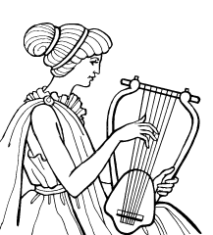
Entertainment - music
Music is a very important part of entertainment at the convivium.
A flute or lyre player is often brought in to provide entertainment for the guests. Sometimes there are even dancers!
However, these entertainers are often enslaved people.
This is Lucilla. She’s really good at playing the lyre (a bit like a harp), she was enslaved just like me.

Slide 10
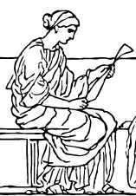
Entertainment - poetry
Sometimes the Roman guests like to read poetry to each other.
A really popular choice is a new poem called the Aeneid (written by a poet called Virgil).
This is a poem which tells the story of how Rome began, so it’s very popular at dinner parties.

Slide 11
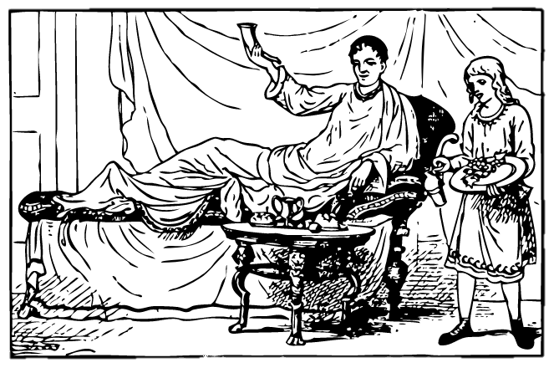
Reclining
The dinner party has started!
A strange thing that the Romans like to do at dinner parties is to lie down when they eat and drink. This is called reclining (the verb for that is recumbere).
This means that the triclinium should have lecti (couches) set up for the guests.

Slide 12
Enslaved people as waiters
As you can see here, slaves bring all the food to the table.
Felix is bringing food from the kitchen for the guests to eat.
Felix is still a little boy, but he has been enslaved so that means he has to work hard for his master.

Slide 13
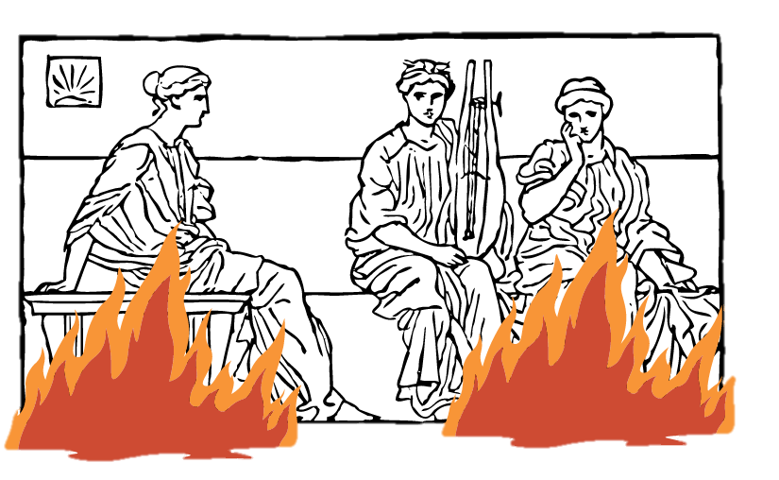
Fire!
Oh no what’s happening! The triclinium is on fire!
I’m going to help put out the flames and save the guests.

Slide 14
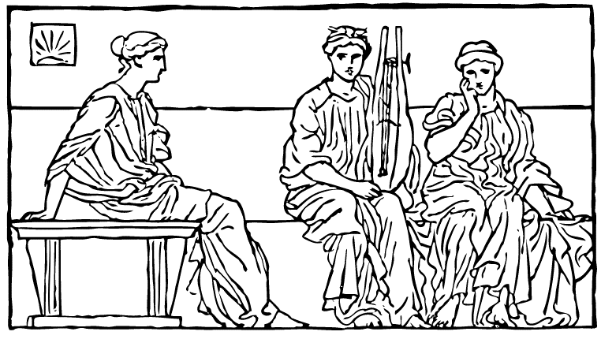
Putting out the fire
That was a close call, the whole house almost burnt down!
Some of the guests think that Marcus should free me as a reward for saving them all from the fire.

Slide 15
Manumissio (setting a slave free)
Marcus does not want to free me because I do so much hard work for him. If he frees me he’ll have to buy another slave.
But Julia has convinced him to free me.

Slide 16
Manumissio at the dinner party
Marcus has invited me to recline in the triclinium along with the other guests.
This is one of the ways that a Roman can carry out manumissio.
This means that I am now a libertus (freedman)!

Slide 17
Meet Marcus Junius Advorix!
Do you remember learning about Roman names? Slaves normally only have one name, so now I have to take two of Marcus’ names so that I have a praenomen, nomen and cognomen.
His full name is
Marcus Junius Cerinthus
so that means that my new name will be
Marcus Junius Advorix

Slide 18
Freedom!
I’m so happy that I’m free now!
I can get my own job and raise my own family, and I won’t belong to anybody.
However, I’m still very sad that the Romans rely so much on slaves. My family from Gaul are still enslaved, and so are my friends Lucilla and Felix.

Slide 19
Thank you for coming!
Thank you for coming with me to learn more about the Roman convivium and my life as an enslaved person!

