Slide 1
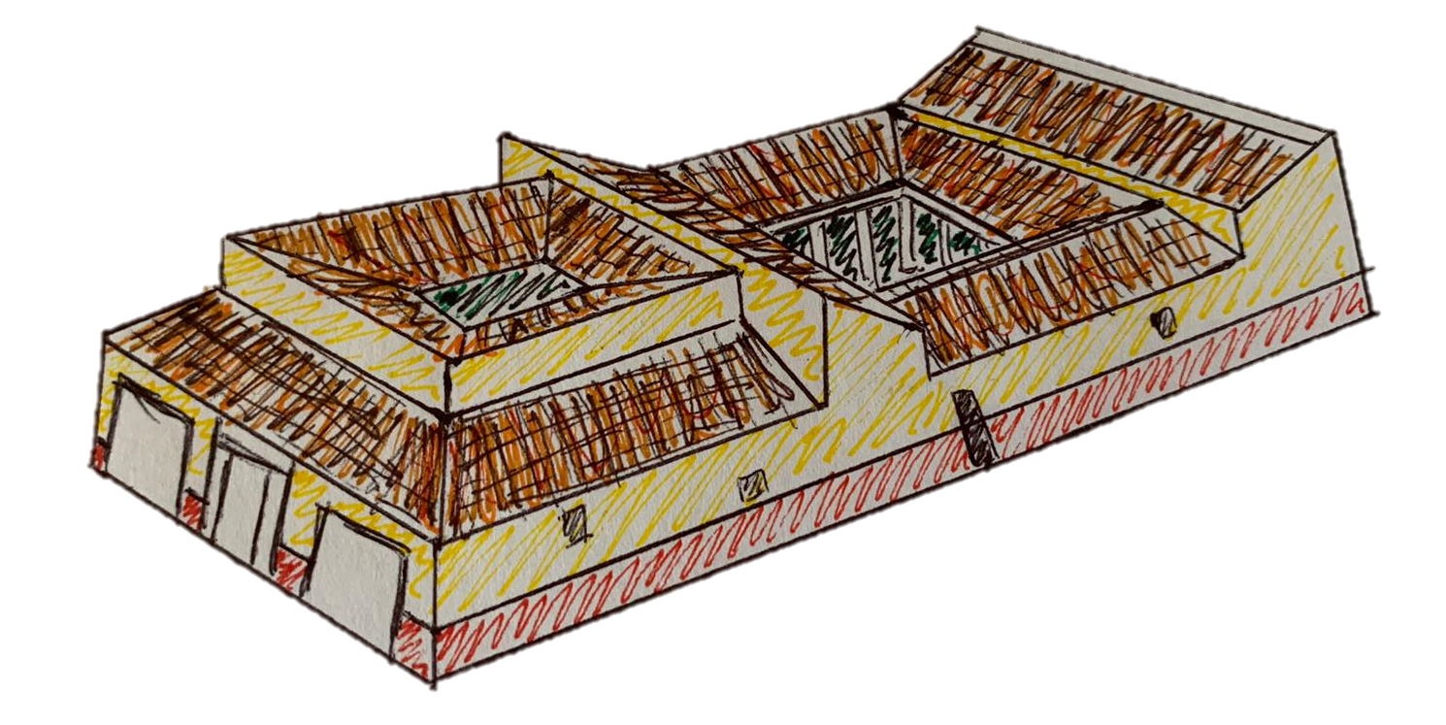
The Roman House

Slide 2
Welcome to the Roman House!
The houses which the Romans lived in were very different to our houses today!
To learn more about the Roman house, Julia is going to give us a tour of her domus (house).
Salve!

Slide 3
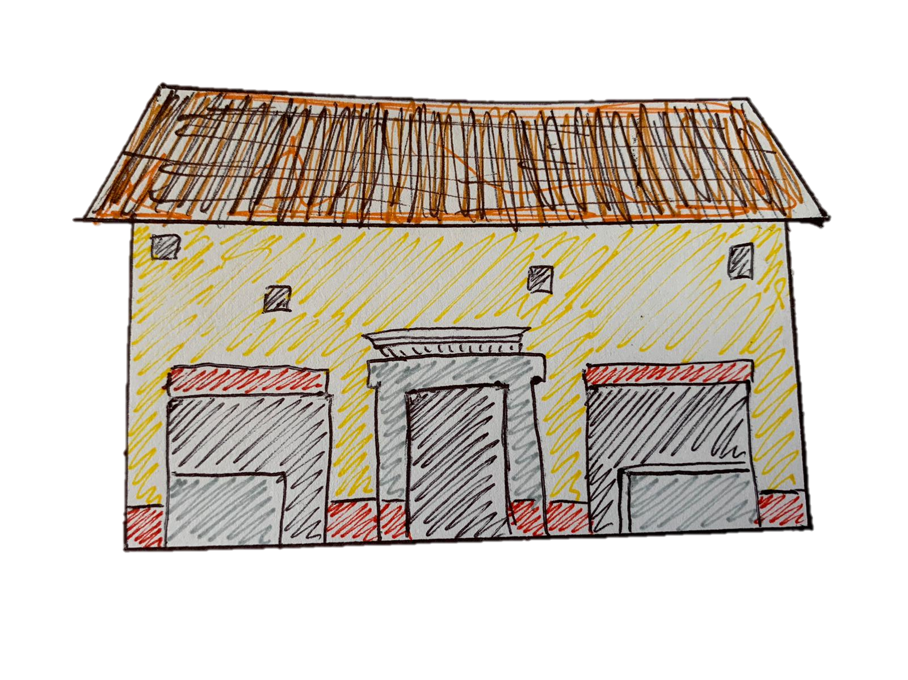
Entering the Roman House
Welcome to my house! You might notice that there are two big rooms at the front of my house. I rent these out to shopkeepers, so a baker could be selling bread by my front door!
You might also notice that my windows are very small. This is to keep my house nice and cool in the hot Italian summers.
Now let’s open the ianua (door) and go inside!

Slide 4
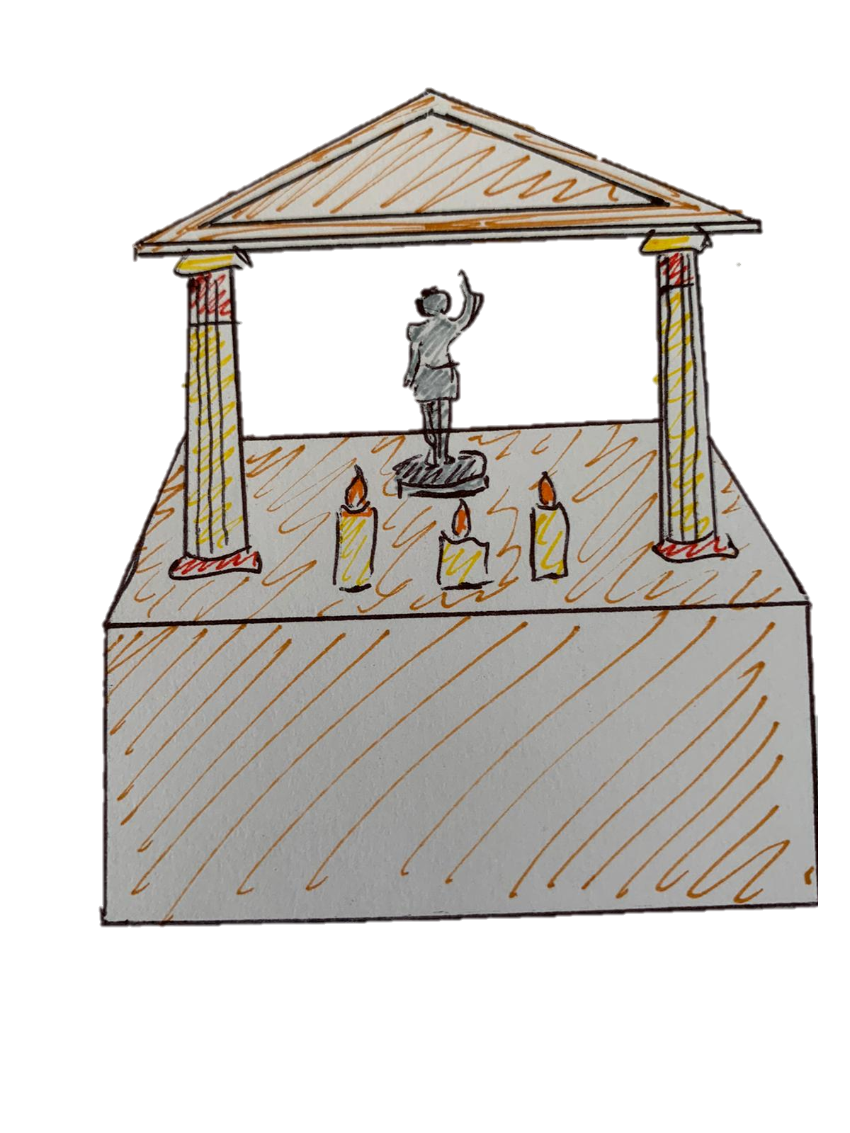
The fauces and lararium
After going through the fauces (entrance hall), we will reach the atrium (main room).
Before exploring the atrium, let’s greet the household gods at the lararium (shrine). It is important for us Romans to worship our household gods because they look after our family.

Slide 5
The atrium and tablinum
The atrium is one of the most important rooms in the house!
In the middle of the floor, there is an impluvium (a pool to catch rainwater). The doors leading out of the atrium are cubicula (bedrooms), and the room directly ahead of us is the tablinum (study room) where I can draw the curtains for more privacy when working.

Slide 6
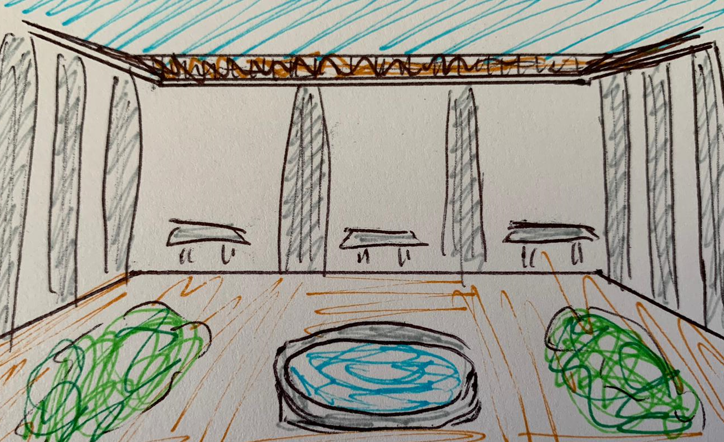
The peristylium
The peristylium (garden with columns) is a nice private garden where I can sit and relax, with plenty of sun and shade!

Slide 7
The triclinium
That was a long tour! Why don’t we have a meal in the triclinium (dining room)?
Us Romans like to lie down on benches to eat our food, and the lovely wall paintings give us something interesting to talk about!

Slide 8
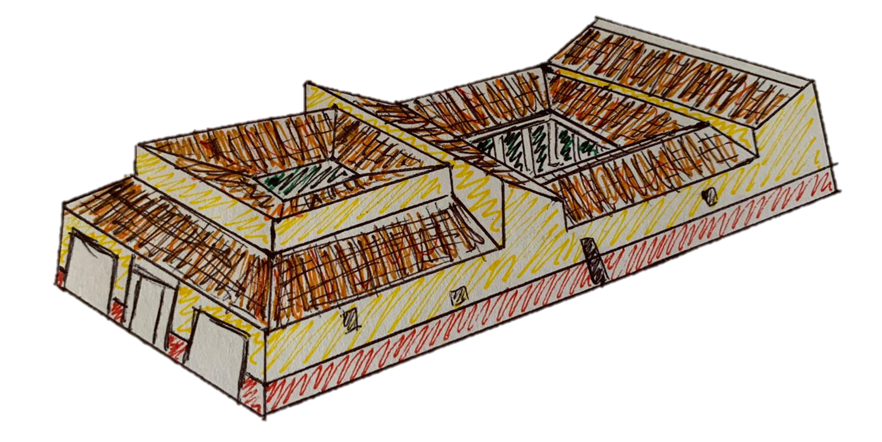
Thank you for visiting!
I hope you enjoyed the tour of my Roman domus! Visit again soon!

