Slide 1
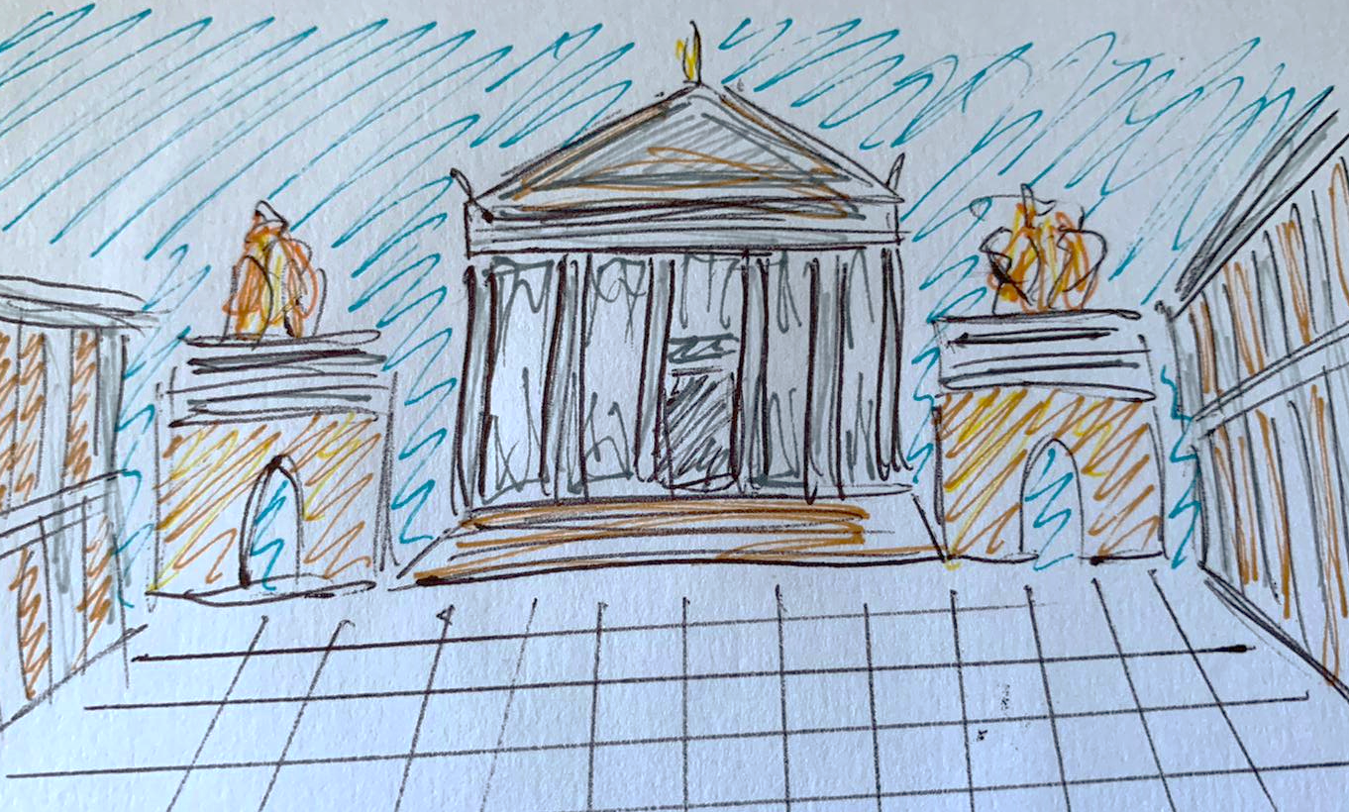
The Roman Town

Slide 2
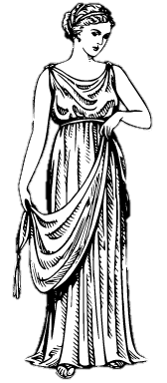
Let’s explore the Roman Town!
Towns were a very important part of Roman life, with lots of different things to see and do.
Now that we have learned about the Roman house, Julia is going to continue her tour to show you around her oppidum (town).
Salve!

Slide 3
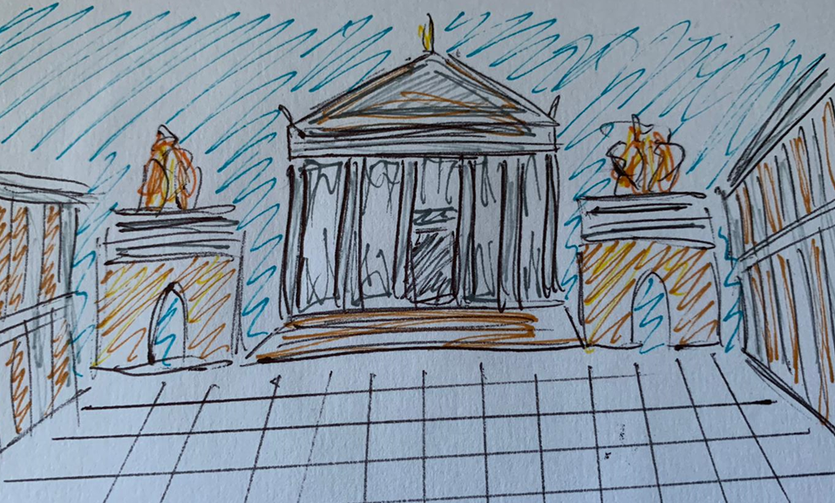
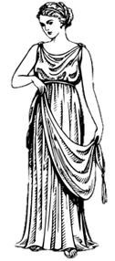
The forum
Where’s the best place to start our tour? I know, the forum (town square)!
The forum was one of the most important parts of a Roman town, and was made up of lots of different parts. Let’s take a closer look!

Slide 4
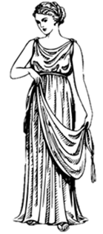
The templum
Let’s start our tour by stopping at the templum (temple). If you have a special request for the gods, this is the place to make it!
You can dedicate gifts such as mini statues, or you can burn an offering on the ara (altar) in front of the temple.

Slide 5
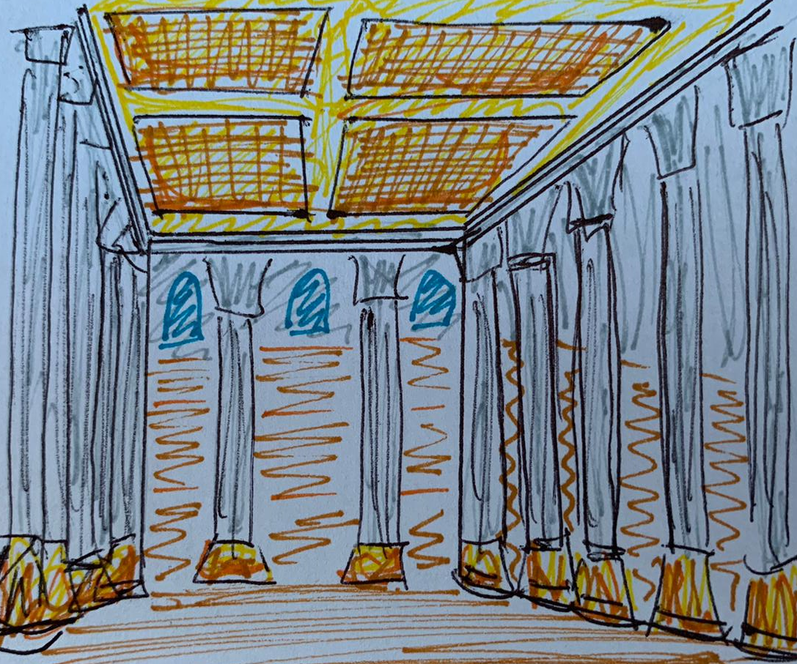
The basilica
Now that we have made a visit to the temple, let’s take a look at the basilica (law courts).This impressive building is where you would have to go if you committed a crime, so that the judges could decide on your punishment! You’d better be on your best behaviour!

Slide 6
The macellum
Where do you go when you need to buy something? To the macellum (market) of course! You can buy all sorts of things here, from food to clothes. I think I’m going to buy myself a new stola (dress).

Slide 7
The taberna
Talking about food has made me hungry! I think I’ll quickly stop off at the taberna (inn) to get something to eat and drink. This is the Roman version of street food after all!

Slide 8
The thermae
The perfect way to end our tour will be to visit the thermae (baths)!
The baths are really popular and a good place to hang out with friends! You can try out pools with hot and cold water, or even get a massage!

Slide 9
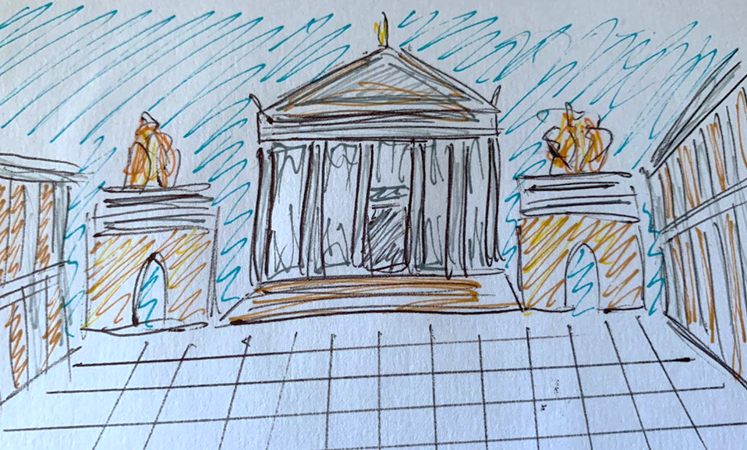
Thank you for visiting!
I hope you enjoyed the tour of my Roman town! Visit again soon!

