Slide 1
Fun Roman Foods!
©Museum of Classical Archaeology 2021

Slide 2
What Did Romans Eat?
You will have seen by now that the Romans loved their dinner parties! What sort of food did they eat there? Well, they didn't have tomatoes, or pizza, or pasta. It could get quite strange...
©Museum of Classical Archaeology 2021

Slide 3
Dormouse!
More of a snack than a main dish, the Romans would hunt dormice during autumn. They would be at their fattest at this point!
They would be particularly popular with upper class Romans, as they could be quite pricey!
They are still eaten in Slovenia and Croatia today!
©Museum of Classical Archaeology 2021

Slide 4
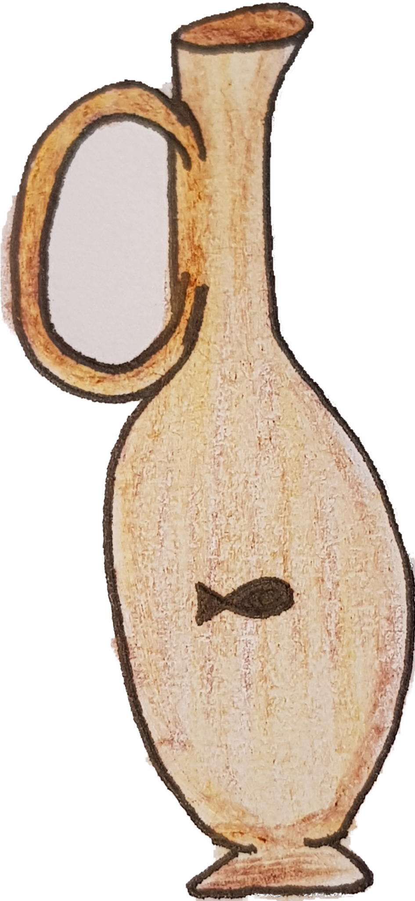
Garum!
Garum was a sauce made from salt and fish guts!
You could have different flavours, such as wine, vinegar or water.
The Romans ate garum with almost everything – you could call it their ketchup!
©Museum of Classical Archaeology 2021

Slide 5
Tounge Tied?
Like us, the Romans ate birds like chickens. But, they also ate some that we wouldn't like parrots and flamingos!
The upper class Romans were particularly fond of flamingos, as they were seen as a sign of wealth.
Their favourite part of the flamingo was the tongue!
©Museum of Classical Archaeology 2021

Slide 6
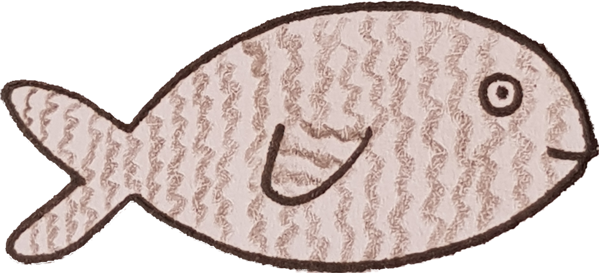
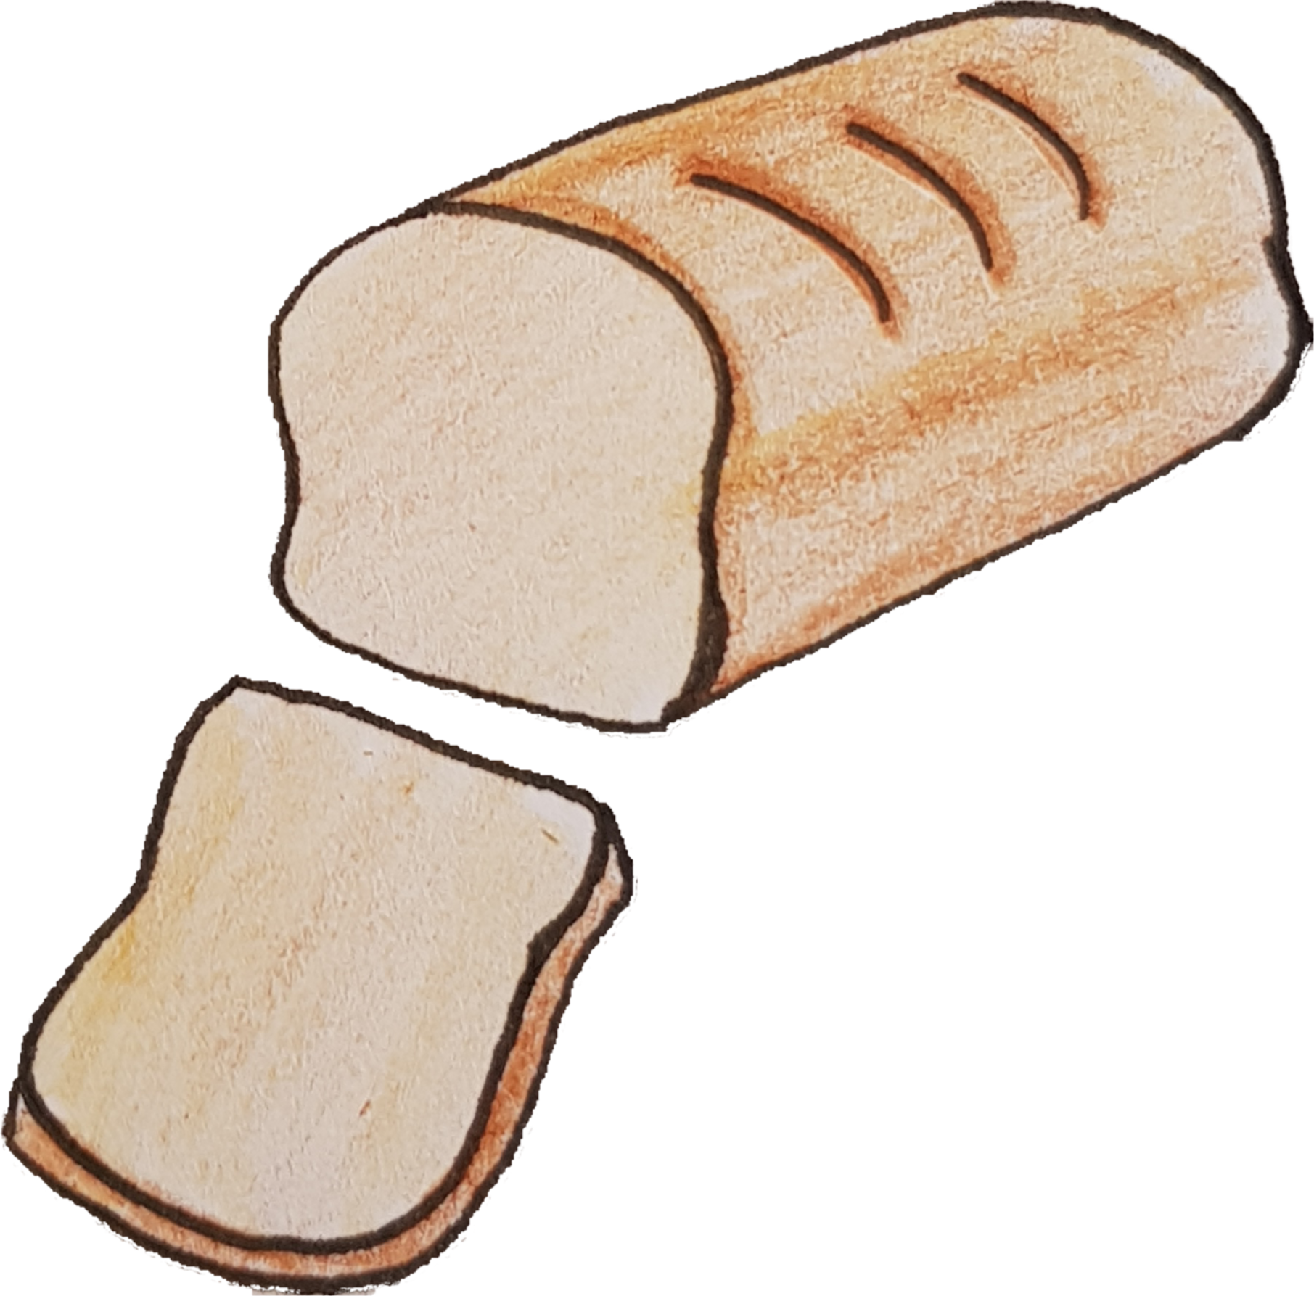
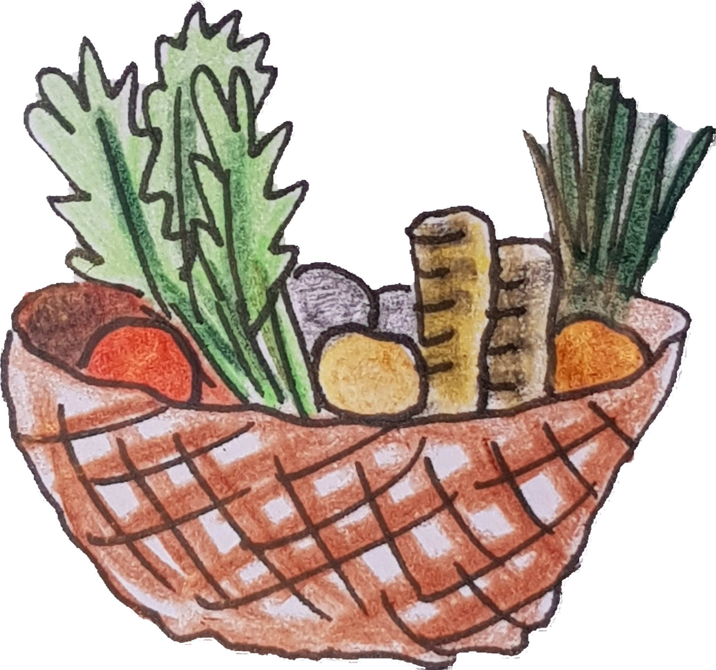
How do we know?
Lots of Romans wrote about what they ate, which has helped us to learn about their diets.
We also have some food left over! In Pompeii, bits of Roman food were left over after a volcano erupted in 79 CE.
We have fish bones, pieces of vegetables and whole loaves of bread. The bread loaves still have their owner's stamps on them, so that no one stole them!
©Museum of Classical Archaeology 2021

Slide 7
Marcus!
You saw that Marcus held a dinner party earlier – do you think he would have eaten any of these foods?
Who knows? Maybe some of the food in Pompeii might be his...
©Museum of Classical Archaeology 2021

